Slide 1

Lecture 12 – Text Clustering and Summarization
Baojian Zhou
DATA130030.01 (自然语言处理)
School of Data Science Fudan University
05/24/2023
Notes:
Pretrained and Fine-Tuning

Slide 2
Outline
Text clustering
Concepts

Slide 3
What is text clustering?
Discover “natural structure”
Group similar objects together
Objects can be documents, terms, passages, websites,…
Example:
What does “similar” mean? Not well defined!

Slide 4
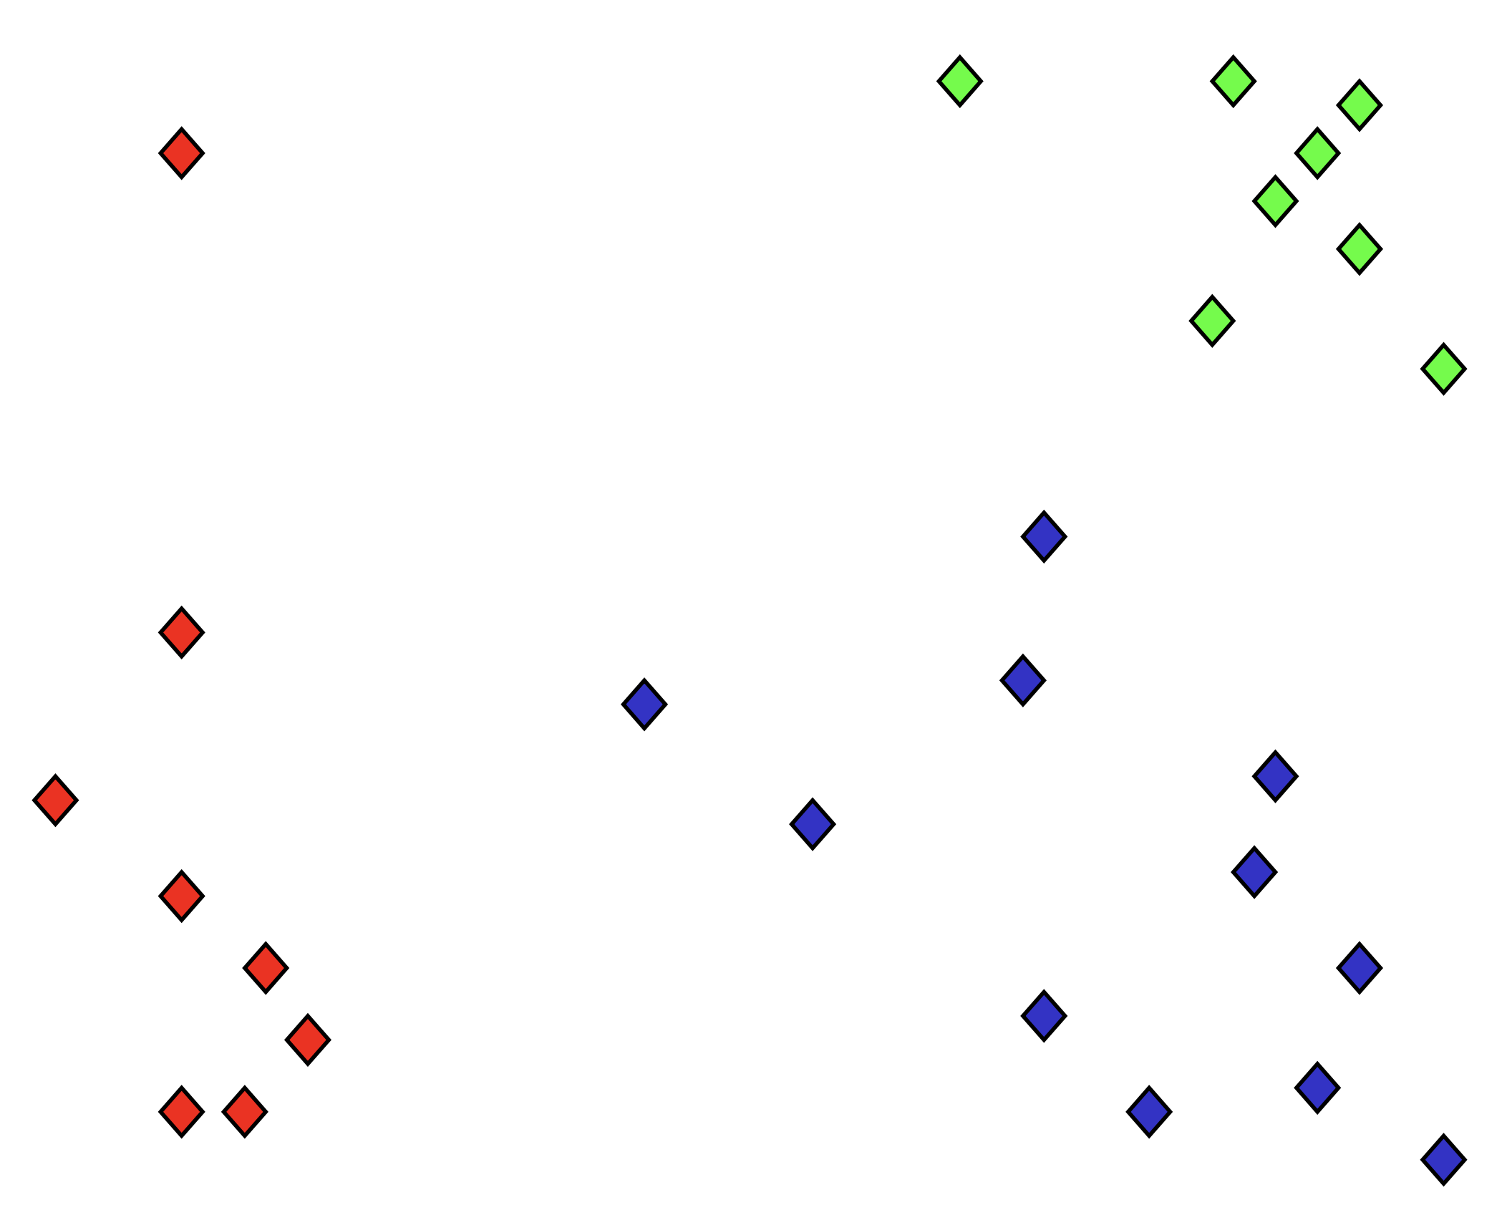
What is clustering?
Organizing data into clusters such that there is
high intra-cluster similarity
low inter-cluster similarity
Find natural groupings among objects

Slide 5
The “Clustering Bias” - similarity
Any two objects can be similar, depending on how you look at them!
Are “car” and “horse” similar?
Are “flower” and “perfume” similar?
A user must define the perspective (i.e., a “bias”) for assessing similarity!

Slide 6
Why text clustering?
Very useful for text mining and exploratory text analysis:
Get a sense about the overall content of a collection (e.g., what are some of the “typical”/representative documents in a collection?)
Link (similar) text objects (e.g., removing duplicated content)
Create a structure on the text data (e.g., for browsing)
As a way to induce additional features (i.e., clusters) for classification of text objects
Examples of applications
Clustering of search results
Understanding major complaints in emails from customers

Slide 7
Outline
Text clustering
Concepts
Methods

Slide 8
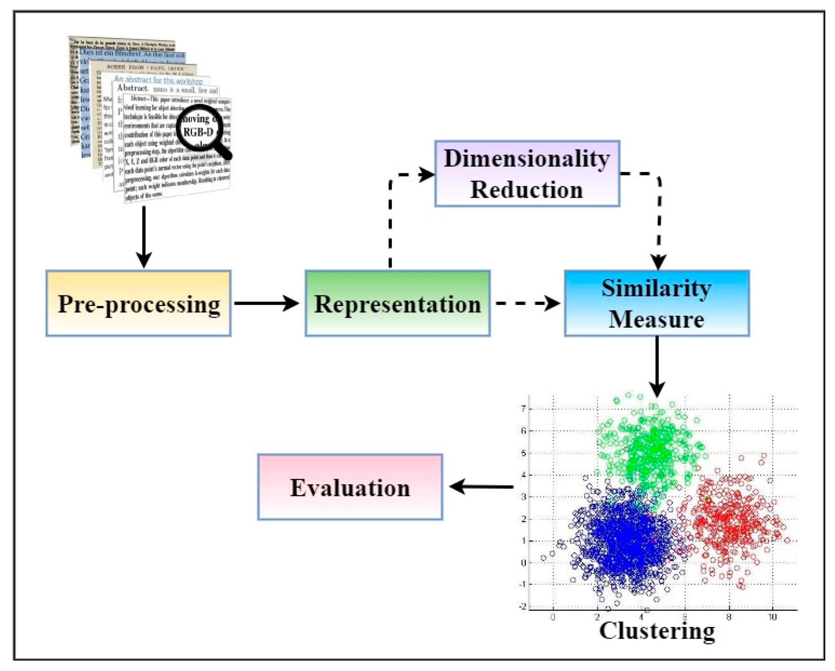
Methods – the paradigm
https://www.mdpi.com/2076-3417/13/1/342

Slide 9
Clustering types: Hard vs. soft
Hard clustering (K-means): Each document belongs to only one cluster
by forcing a document into the cluster corresponding to the unigram LM most likely used to generate the document
Soft clustering(Mixture-Model): A document can belong to more than one cluster
You may want to put a pair of sneakers in two clusters: 1. sports apparel（运动服装） and 2. shoes
Other Clustering Algorithms
Flat algorithms
Usually start with a random (partial) partitioning
Refine it iteratively
K-means clustering
Hierarchical algorithms
Bottom-up
Top-down

Slide 10
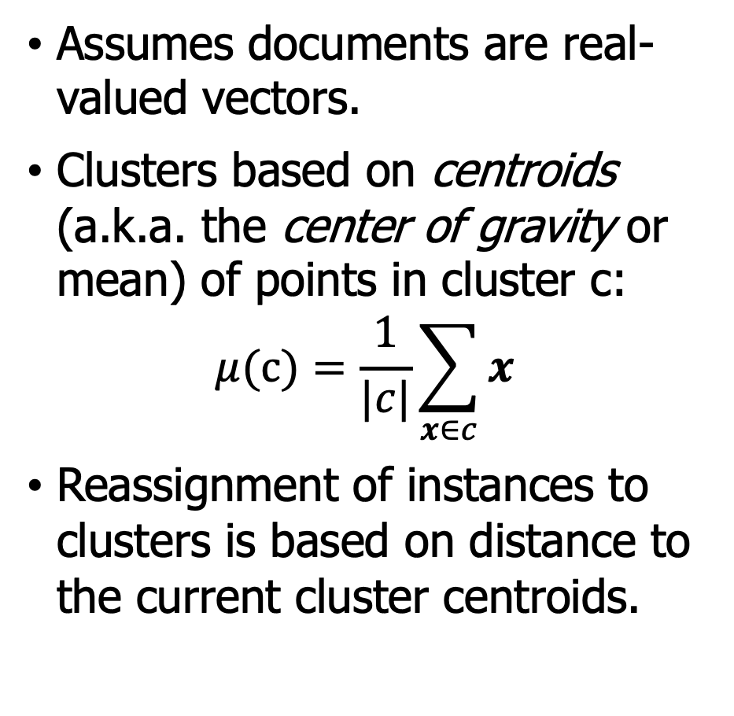
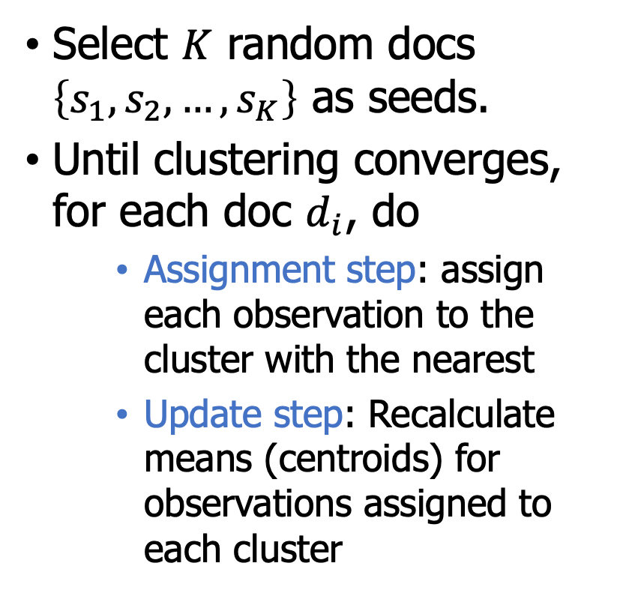
K-Means
Assumes documents are real-valued vectors.
Clusters based on centroids (a.k.a. the center of gravity or mean) of points in cluster c:
$$μ(c)=\frac{1}{|c|}\sum_{x∈c}{x}$$
Reassignment of instances to clusters is based on distance to the current cluster centroids.
Select $K$ random docs $\left\{s_{1},s_{2},…,s_{K}\right\}$ as seeds.
Until clustering converges, for each doc $d_{i}$, do
Assignment step: assign each observation to the cluster with the nearest
Update step: Recalculate means (centroids) for observations assigned to each cluster

Slide 11
K-Means example (K=2)
Pick seeds
Reassign clusters
Compute centroids
Reassign clusters
x
x
x
Compute centroids
x
x
x
Reassign clusters
Converged!

Slide 12
K-Means - Seed Choice
Results can vary based on random seed selection.
Some seeds can result in poor convergence rate, or convergence to sub-optimal clusters.
Select good seeds using a heuristic (e.g., doc least similar to any existing mean)
Try out multiple starting points
Initialize with the results of another method.
Example showing
sensitivity to seeds
A B C
D E F
In the above, if you start
with B and E as centroids
you converge to {A,B,C}
and {D,E,F}
If you start with D and F
you converge to
{A,B,D,E} {C,F}

Slide 13
K-Means - Other issues
How many clusters?
Number of clusters K is given
Partition n docs into predetermined number of clusters
Finding the “right” number of clusters is part of the problem
Given docs, partition into an “appropriate” number of subsets
E.g., for query results - ideal value of K not known
K not specified in advance
Given a clustering, define the benefit for a doc to be the cosine similarity to its centroid
Define the total benefit to be the sum of the individual doc benefits.

Slide 14
K-Means - K not specified in advance
For each cluster, we have a Cost C.
Thus for a clustering with K clusters, the Total Cost is KC.
Define the Value of a clustering to be =
Total Benefit - Total Cost.
Find the clustering of highest value, over all choices of K.
Total benefit increases with increasing K. But can stop when it doesn’t increase by “much”. The Cost term enforces this.

Slide 15
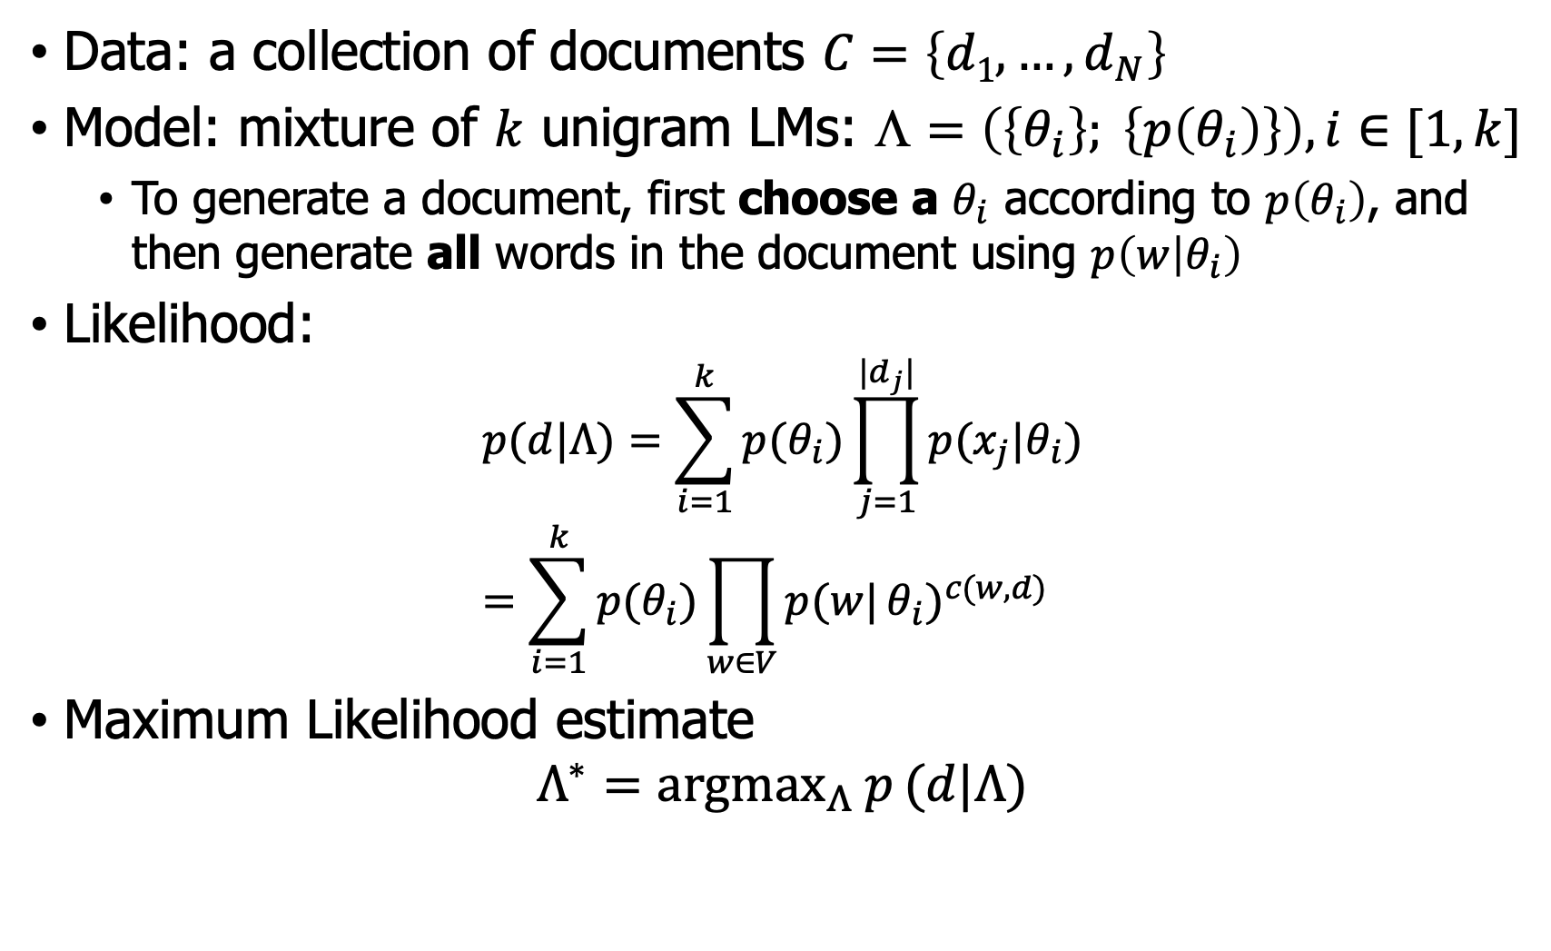
Mixture model - for document clustering
Data: a collection of documents $C=\left\{d1, …, d_{N}\right\}$
Model: mixture of $k$ unigram LMs: $☹=\left(\left\{θ_{i}\right\}; \left\{p\left(θ_{i}\right)\right\}\right), i∈[1,k]$
To generate a document, first choose a $θ_{i}$ according to $p\left(θ_{i}\right)$, and then generate all words in the document using $p\left(w | θ_{i}\right)$
Likelihood:
$$p(d|Λ)=\sum_{i=1}^{k}{p(θ_{i})\prod_{j=1}^{|d_{j}|}{p(x_{j}|θ_{i})}} \\ =\sum_{i=1}^{k}{p(θ_{i})\prod_{w∈V}{p(w|}θ_{i})^{c(w,d)}}$$
Maximum Likelihood estimate
$$Λ^{∗}={argmax}_{Λ}{p}(d|Λ)$$

Slide 16
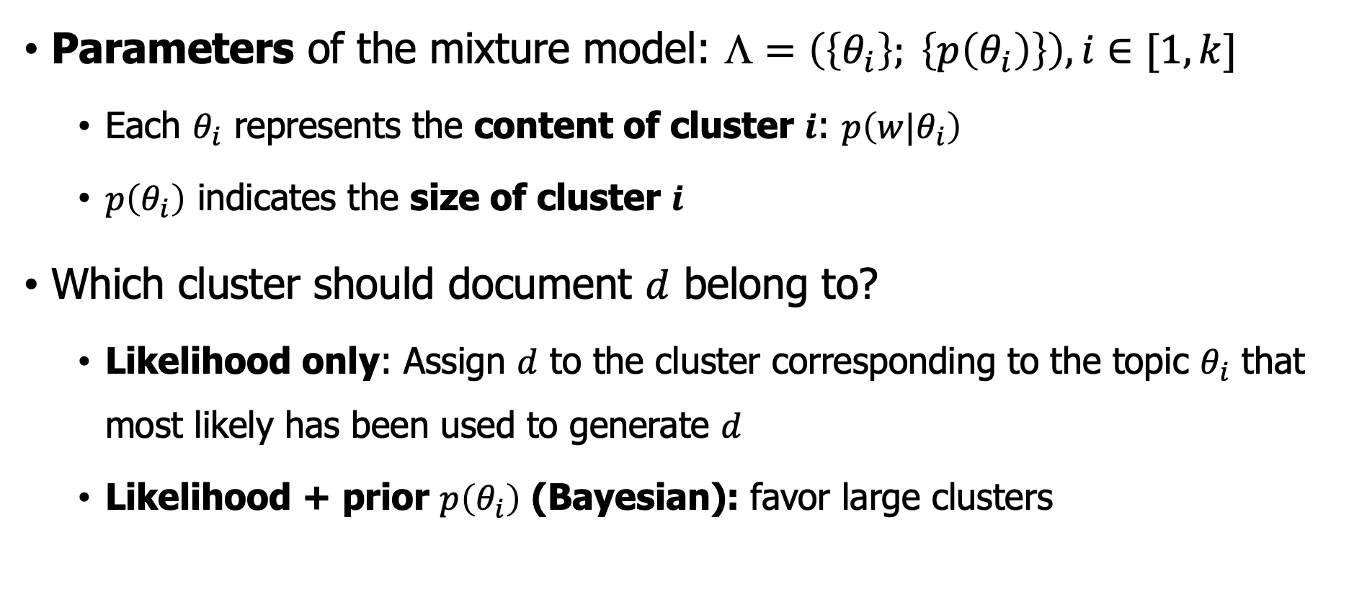
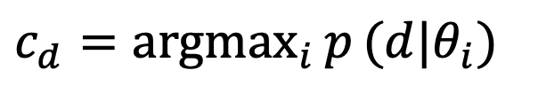
Mixture model - Cluster allocation
Parameters of the mixture model: $☹=\left(\left\{θ_{i}\right\}; \left\{p\left(θ_{i}\right)\right\}\right), i∈[1,k]$
Each $θ_{i}$ represents the content of cluster $i$: $p\left({w|θ}_{i}\right)$
$p\left(θ_{i}\right)$ indicates the size of cluster $i$
Which cluster should document $d$ belong to?
Likelihood only: Assign $d$ to the cluster corresponding to the topic $θ_{i}$ that most likely has been used to generate $d$
Likelihood + prior $p\left(θ_{i}\right)$ (Bayesian): favor large clusters
$$c_{d}={argmax}_{i}{p}(d|θ_{i})$$

Slide 17
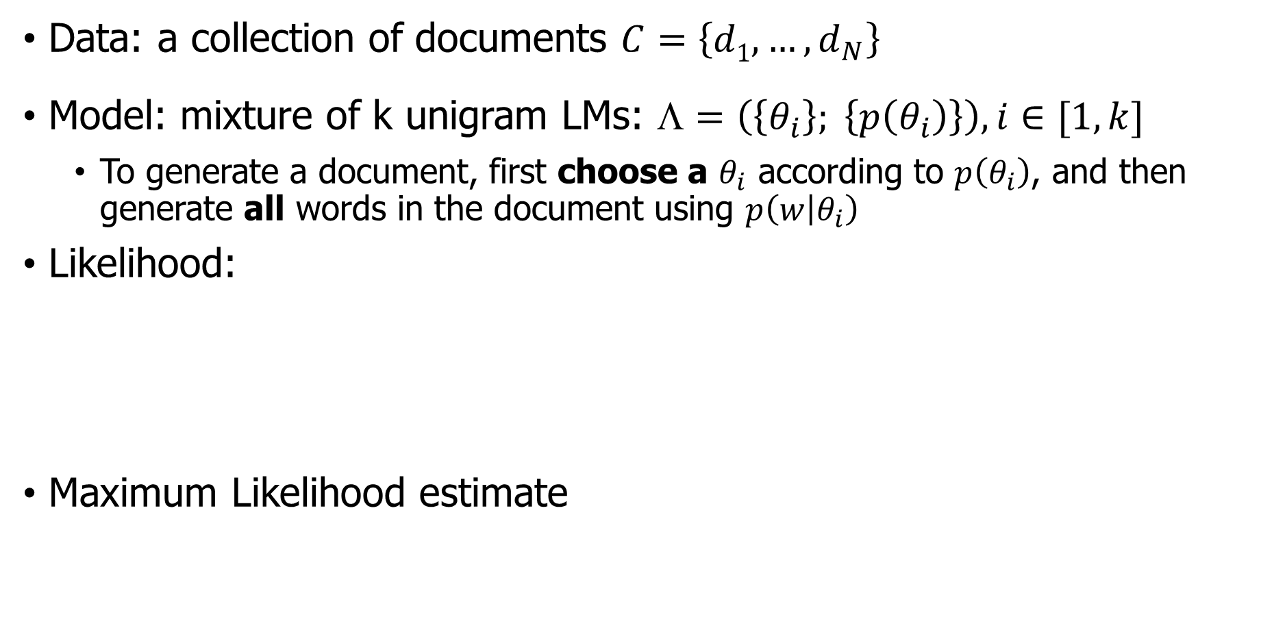
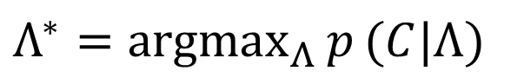
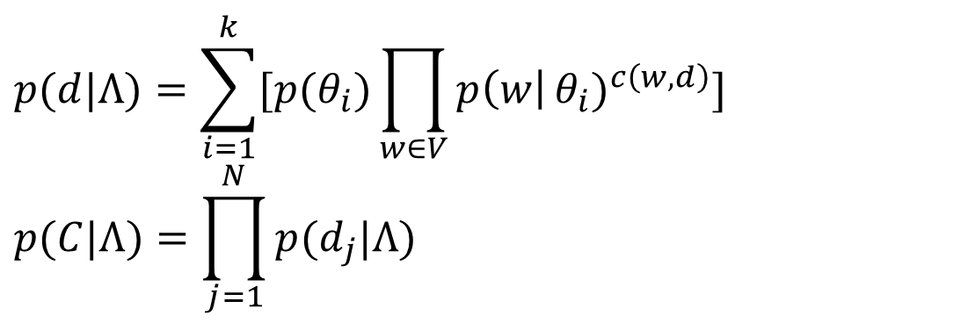
Mixture model - the ML estimate?
Data: a collection of documents $C=\left\{d1, …, d_{N}\right\}$
Model: mixture of k unigram LMs: $☹=\left(\left\{θ_{i}\right\}; \left\{p\left(θ_{i}\right)\right\}\right), i∈[1,k]$
To generate a document, first choose a $θ_{i}$ according to $p\left(θ_{i}\right)$, and then generate all words in the document using $p\left(w | θ_{i}\right)$
Likelihood:
Maximum Likelihood estimate
$$p(d|Λ)=\sum_{i=1}^{k}{[p(θ_{i})\prod_{w∈V}{p\left(w\right|}}θ_{i})^{c\left(w,d\right)}] \\ p(C|Λ)=\prod_{j=1}^{N}{p(d_{j}|Λ)}$$
$$Λ^{∗}={argmax}_{Λ}{p}(C|Λ)$$

Slide 18
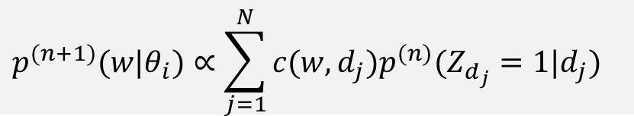
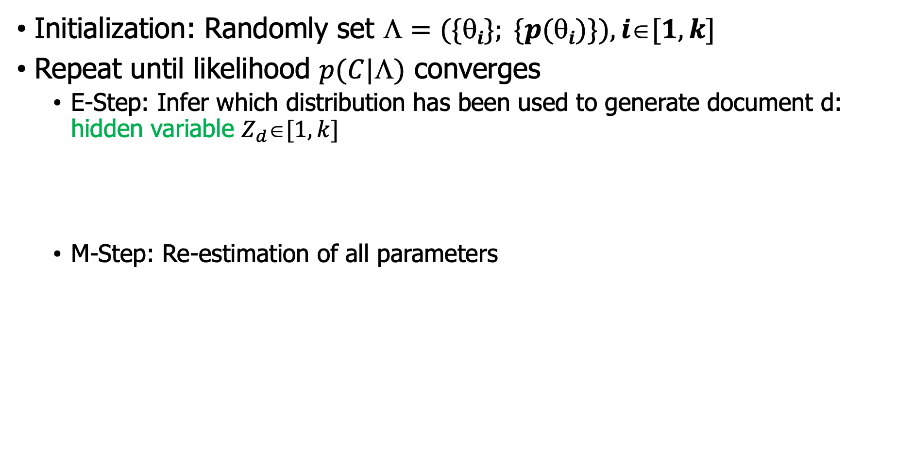
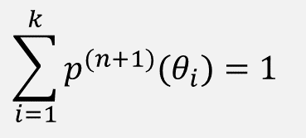
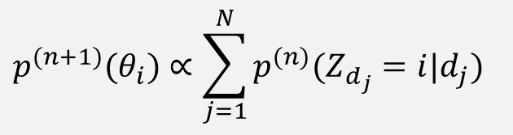
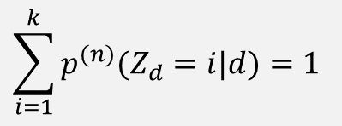
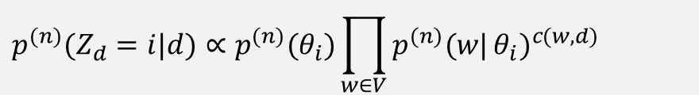
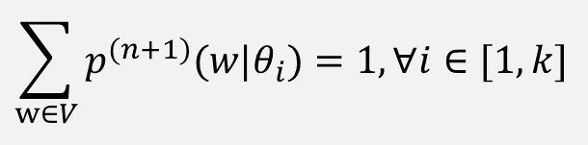
Mixture model - EM Algorithm
Initialization: Randomly set $☹=(\{i\}; \{p(i)\}), i[1,k]$
Repeat until likelihood $p(C|☹)$ converges
E-Step: Infer which distribution has been used to generate document d: hidden variable $Z_{d}[1, k]$
M-Step: Re-estimation of all parameters
$$p^{(n)}(Z_{d}=i|d)∝p^{(n)}(θ_{i})\prod_{w∈V}{p^{(n)}(w|}θ_{i})^{c(w,d)}$$
$$\sum_{i=1}^{k}{p^{(n)}(Z_{d}=i|d)}=1$$
$$p^{(n+1)}(θ_{i})∝\sum_{j=1}^{N}{p^{(n)}(Z_{d_{j}}=i|d_{j})}$$
$$\sum_{i=1}^{k}{p^{(n+1)}(θ_{i})}=1$$
$$p^{(n+1)}(w|θ_{i})∝\sum_{j=1}^{N}{c(w,d_{j})p^{(n)}(Z_{d_{j}}=1|d_{j})}$$
$$\sum_{w∈V}{p^{(n+1)}(w|θ_{i})}=1, ∀i∈[1,k]$$

Slide 19
Outline
Text clustering
concepts
Methods
Evaluation

Slide 20
What Is A Good Clustering
Internal criterion: internal criterion is a measure of goodness for a cluster that does not involve external information. It solely depends on the clustered data itself.
Inter-cluster distances are maximized
Intra-cluster distances are minimized
Notes:
Silhouette Index
Davies–Bouldin Index (DBI)
Dunn Index

Slide 21
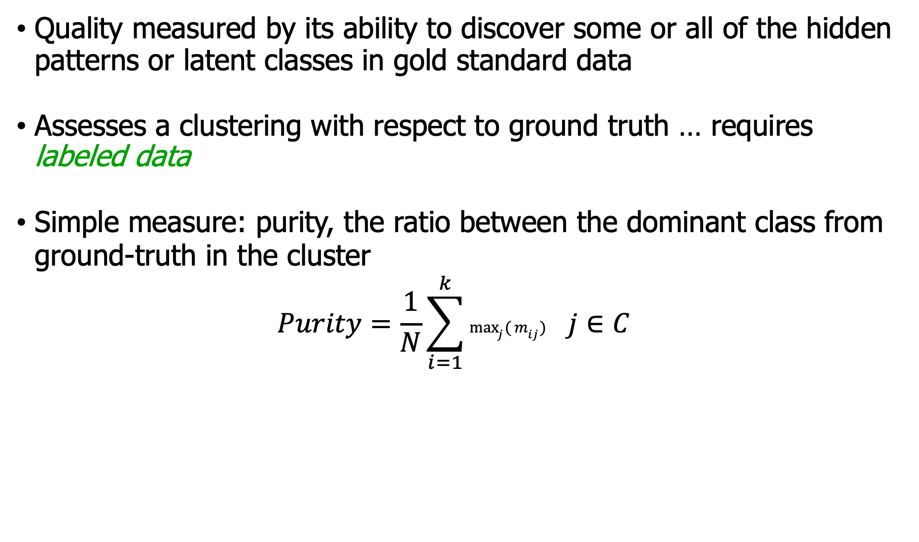
External Evaluation of Cluster Quality
Quality measured by its ability to discover some or all of the hidden patterns or latent classes in gold standard data
Assesses a clustering with respect to ground truth … requires labeled data
Simple measure: purity, the ratio between the dominant class from ground-truth in the cluster
$$Purity=\frac{1}{N}\sum_{i=1}^{k}{\max_{j}{(}m_{ij}) }j∈C$$

Slide 22
Summary of Text Clustering
Text clustering is an unsupervised text mining technique to
obtain an overall picture of the text content (exploring text data)
discover interesting clustering structures in text data
Many approaches are possible
Strong clusters tend to show up no matter what method used
Effectiveness of a method highly depends on whether the desired clustering bias is captured appropriately
Deciding the optimal number of clusters is generally a difficult problem for any method due to the unsupervised nature
Evaluation of clustering results can be done both directly and indirectly

Slide 23
Outline
Text clustering
Text Summarization
Concepts

Slide 24
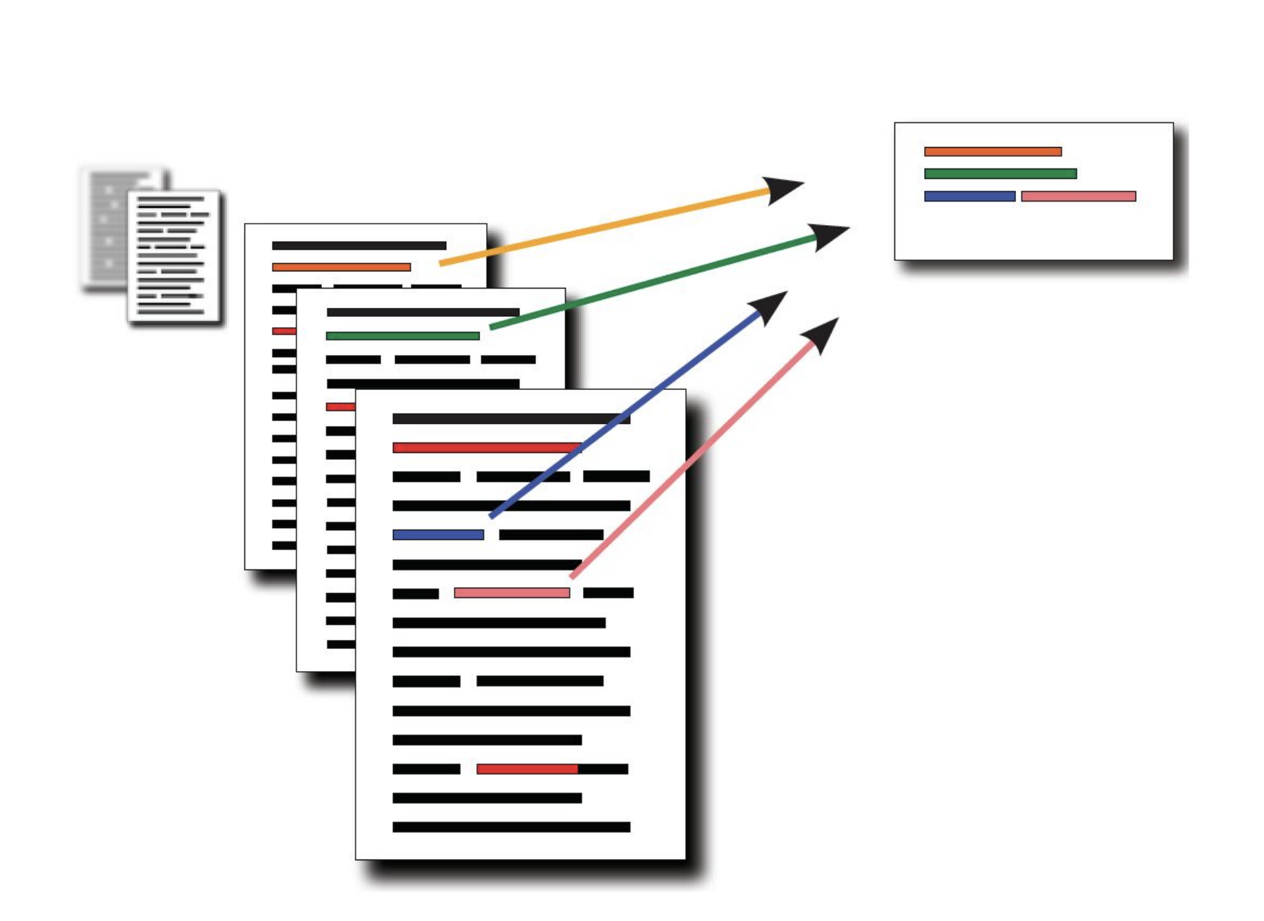
Text Summarization
Goal: produce an abridged version of a text that contains information that is important or relevant to a user.
Why summarization?
Summaries saves reading time.
Summaries help in the selection of documents when conducting research.
…
Summarization Applications
outlines or abstracts of any document, article, etc.
summaries of email threads
action items from a meeting
simplifying text by compressing sentences
Notes:
Summaries saves reading time.
Summaries help in the selection of documents when conducting research.
Indexing is more successful when automatic summarization is used.
When compared to human summarizers, automatic summary systems are less biased.
Because they provide personalized information, personalized summaries are important in question-answering systems.
Commercial abstract services can improve the number of texts they can process by using automatic or semi-automatic summarizing techniques.

Slide 25
Text Summarization categories
Two types of summarization by outputs:
Extractive summarization
The summary contains the most important sentences from the original input text sentences without any paraphrasing or changes. (create the summary from phrases or sentences in the source document(s))
Abstractive text summarization
The summary usually uses different words and phrases to concisely convey the same meaning as the original text. (express the ideas in the source documents using (at least in part) different words)
In the real world, often both are used together. You may want abstractive summarization for some sections of the document and extractive summarization for others.

Slide 26
Text Summarization categories
Input
Single-Document Summarization (SDS)
Multiple-Document Summarization (MDS)
Output
Extractive
Abstractive
Compressive
Focus
Generic
Query-focused summarization
Machine learning methods
Supervised/Unsupervised
Single-document summarization
Given a single document, produce: Abstract, Outline, Headline
Multiple-document summarization
Given a group of documents, produce a gist of the content: a series of news stories on the same event and a set of web pages about some topic or question

Slide 27
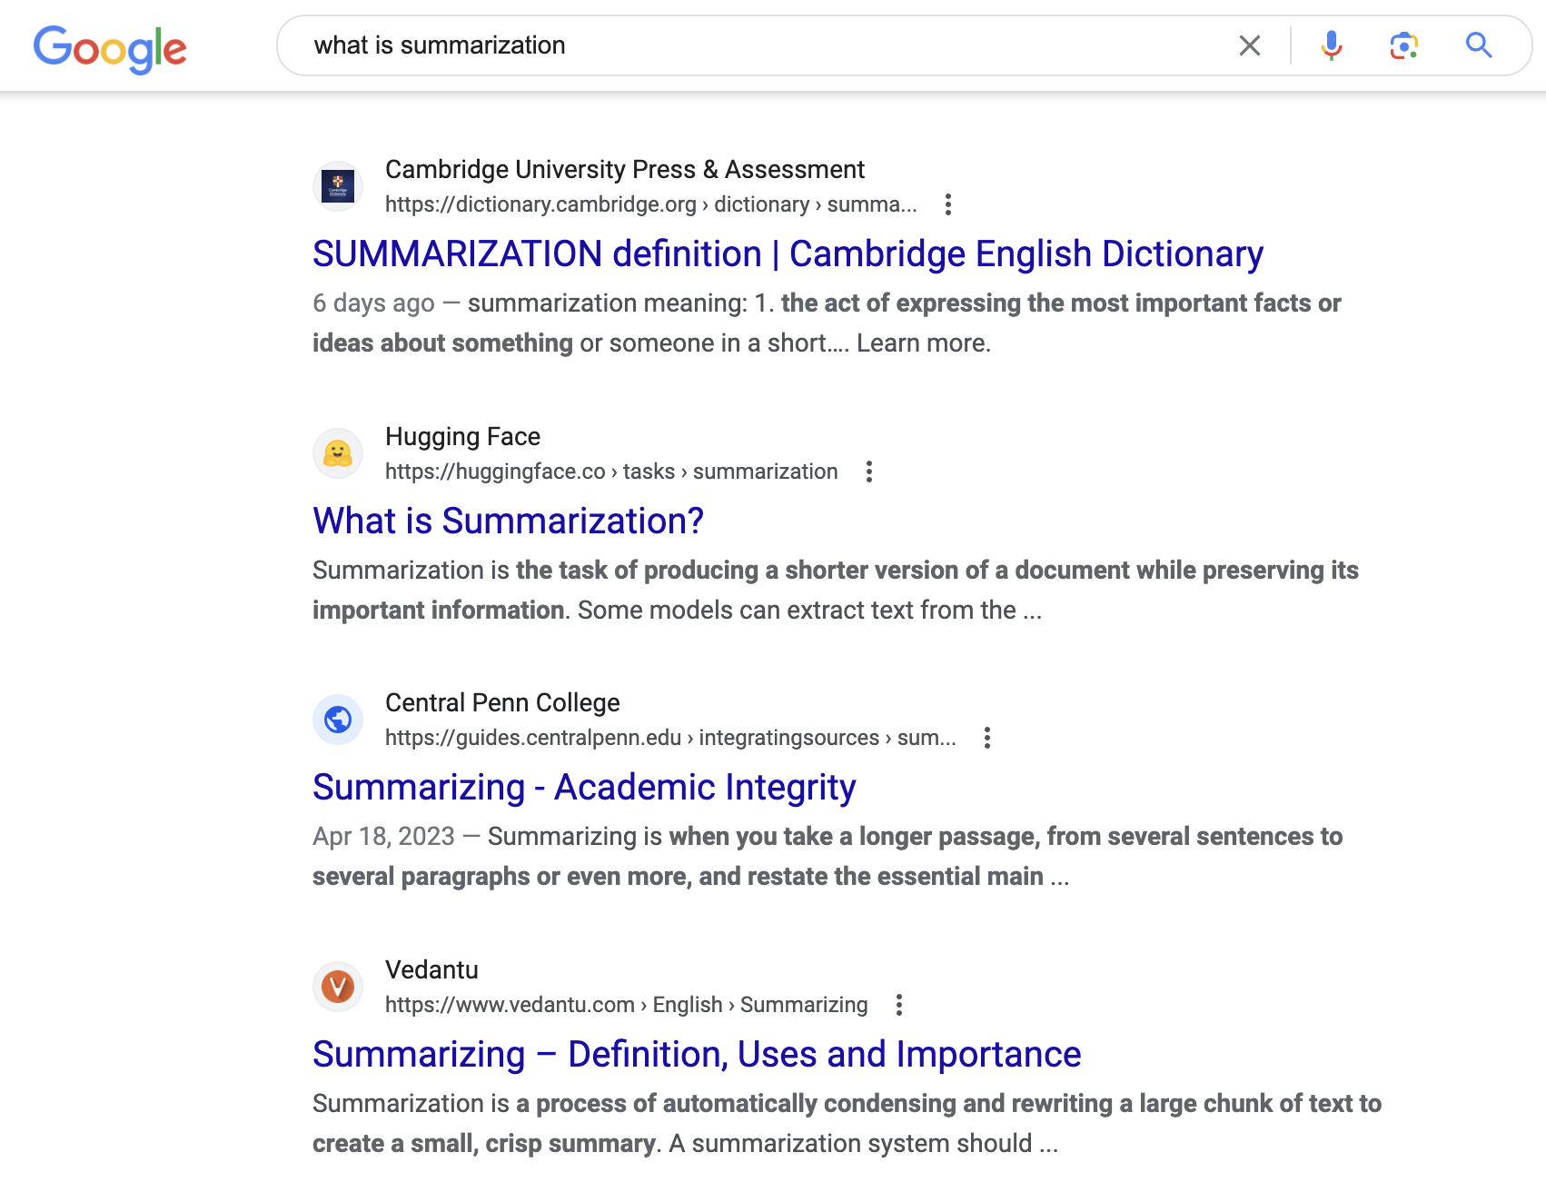
Query-focused Summarization
Generic summarization
Summarize the content of a document
Query-focused summarization
summarize a document with respect to an information need expressed in a user query.
a kind of complex question answering:
Answer a question by summarizing a document that has the information to construct the answer
Create snippets(摘录) summarizing a web page for a query, Google: 156 characters (about 26 words) plus title and link

Slide 28
History of Summarization
Since 1950s
Concept Weight (Luhn, 1958), Centroid (Radev et al., 2004), LexRank (Erkan and Radev, 2004), TextRank (Mihalcea and Tarau, 2004), Sparse Coding (He et al., 2012; Li et al., 2015)
Feature + Regression (Min et al., 2012; Wang et al., 2013)
Most of the summarization methods are extractive
Abstractive summarization is full of challenges
Some indirect methods employ sentence fusing (Barzilay and McKeown, 2005) or phrase merging (Bing et al., 2015).
The indirect strategies will do harm to the linguistic quality of the constructed sentences
Notes:
Concept weight 根据单词或术语在文档中的重要性为其分配权重，以表示文档的整体内容或概念。Concept Weight的理念是识别并强调捕捉文档整体内容的最重要单词。
间接策略可能会对构建的句子的语言质量造成一定的影响，但具体影响的程度取决于所采用的策略以及使用的语境。需要考虑构建的句子的目的和受众。
间接策略通常涉及对信息进行改写或转述，以传达特定的含义而不直接陈述。虽然在某些情况下这种方法可能会有所帮助，但也可能引入一些潜在问题：
清晰度：与直接陈述相比，间接策略可能导致句子不够清晰或简明。改写可能会引入歧义或模糊预期的含义，特别是当处理复杂或技术性信息时。
精确性：直接陈述通常允许更精确和准确的沟通。间接策略可能牺牲了准确性，以试图间接传达信息，从而可能导致失去精确性。
风格和语气：使用间接策略可能会影响构建句子的风格和语气。根据语境，改写可能听起来过于正式、冗长或晦涩，这可能会影响可读性和参与度。
文化和语言细微差别：不同的语言和文化对于直接性和间接性有不同的惯例。间接策略可能并不总是符合特定受众的语言期望，从而可能导致误解或错误解读。
然而，值得注意的是，以上提到的影响因素也要考虑具体的语境和受众的特点。

Slide 29
Outline
Text clustering
Text Summarization
Concepts
Evaluating Summaries: ROUGE
Notes:
How to detect salient words/sentences?

Slide 30
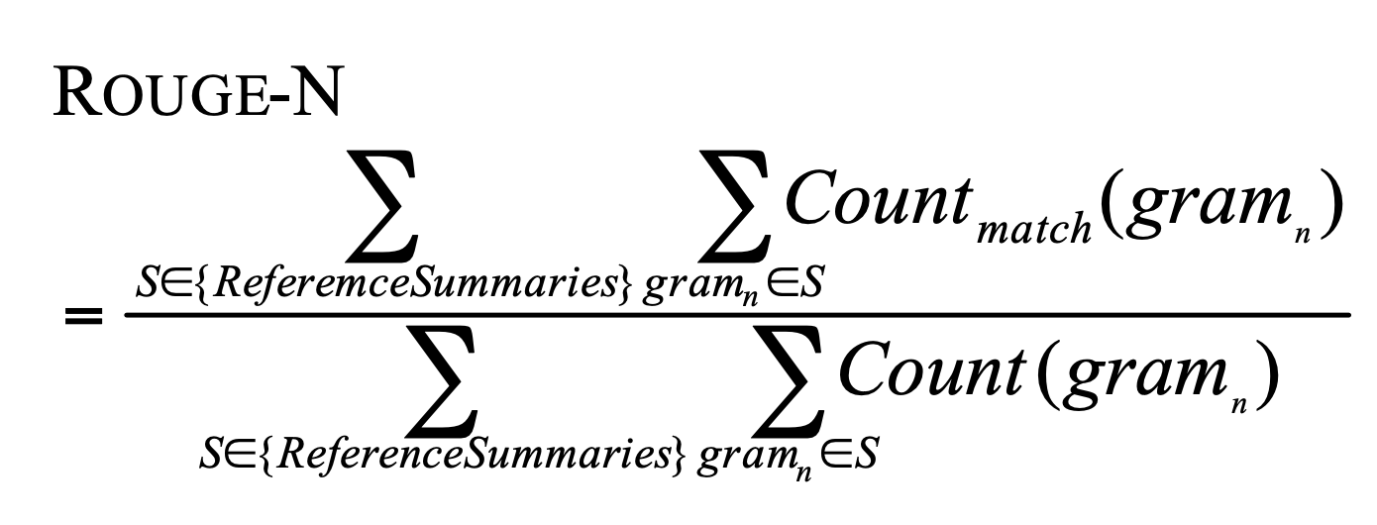
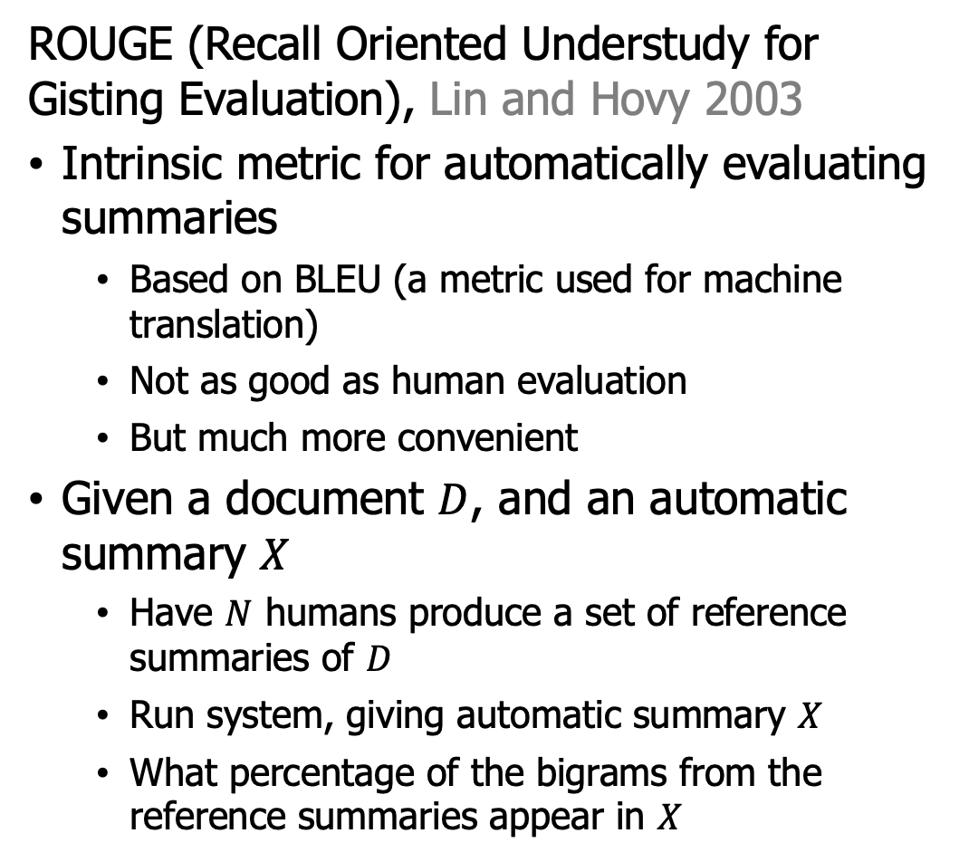
Evaluating Summaries: ROUGE
ROUGE (Recall Oriented Understudy for Gisting Evaluation), Lin and Hovy 2003
Intrinsic metric for automatically evaluating summaries
Based on BLEU (a metric used for machine translation)
Not as good as human evaluation
But much more convenient
Given a document $D$, and an automatic summary $X$
Have $N$ humans produce a set of reference summaries of $D$
Run system, giving automatic summary $X$
What percentage of the bigrams from the reference summaries appear in $X$
Notes:
Recall Oriented Understudy for Gisting Evaluation “基于召回的摘要评估助手”。

Slide 31
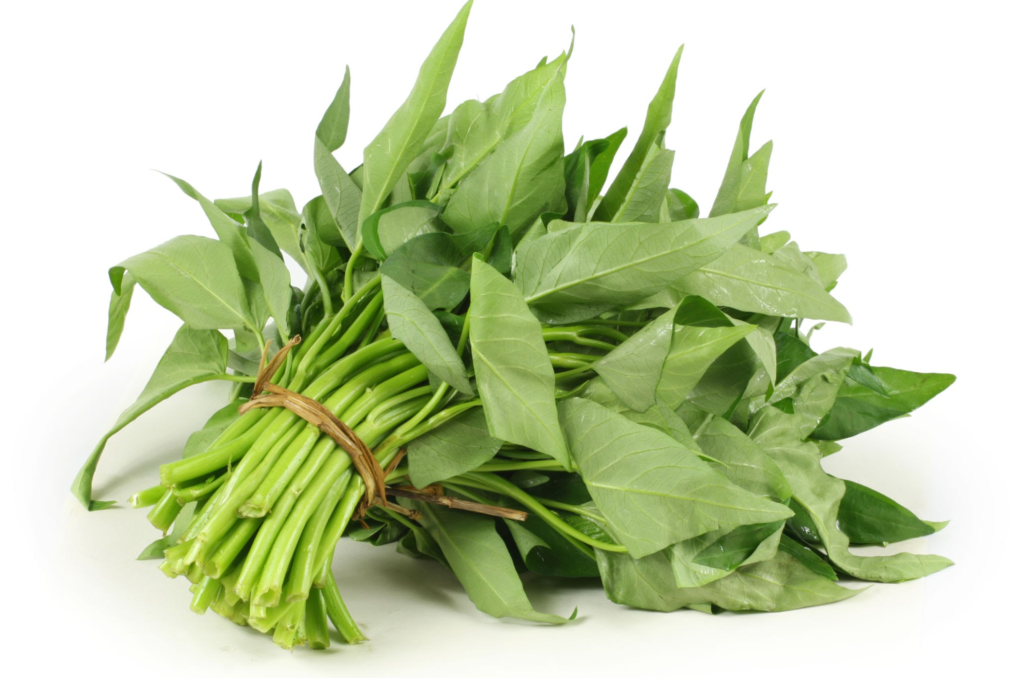
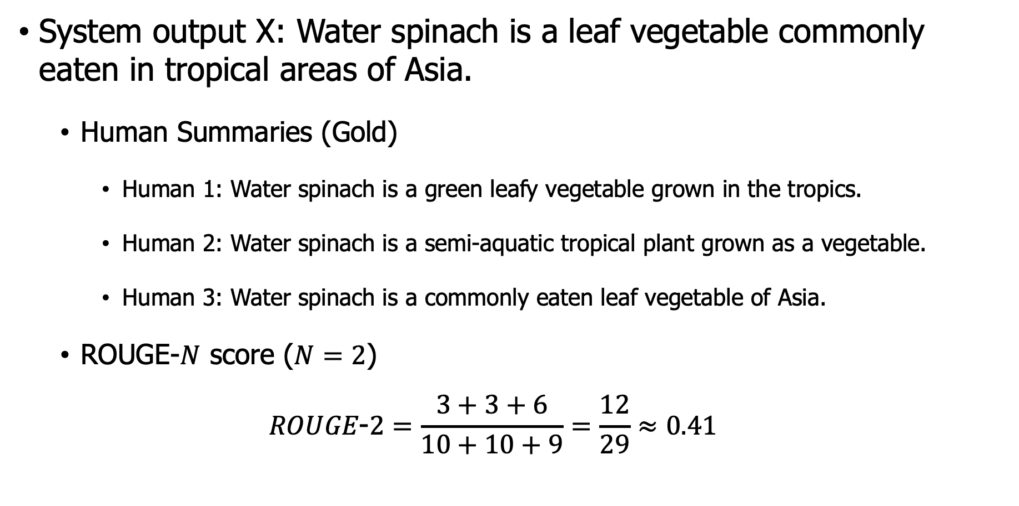
A ROUGE example: Q: “What is water spinach?”
System output X: Water spinach is a leaf vegetable commonly eaten in tropical areas of Asia.
Human Summaries (Gold)
Human 1: Water spinach is a green leafy vegetable grown in the tropics.
Human 2: Water spinach is a semi-aquatic tropical plant grown as a vegetable.
Human 3: Water spinach is a commonly eaten leaf vegetable of Asia.
ROUGE-$N$ score ($N=2$)
$$ROUGE\text{−}2=\frac{3+3+6}{10+10+9}=\frac{12}{29}≈0.41$$

Slide 32
Outline
Text clustering
Text Summarization
Concepts
Evaluating Summaries: ROUGE
Methods
Notes:
How to detect salient words/sentences?

Slide 33
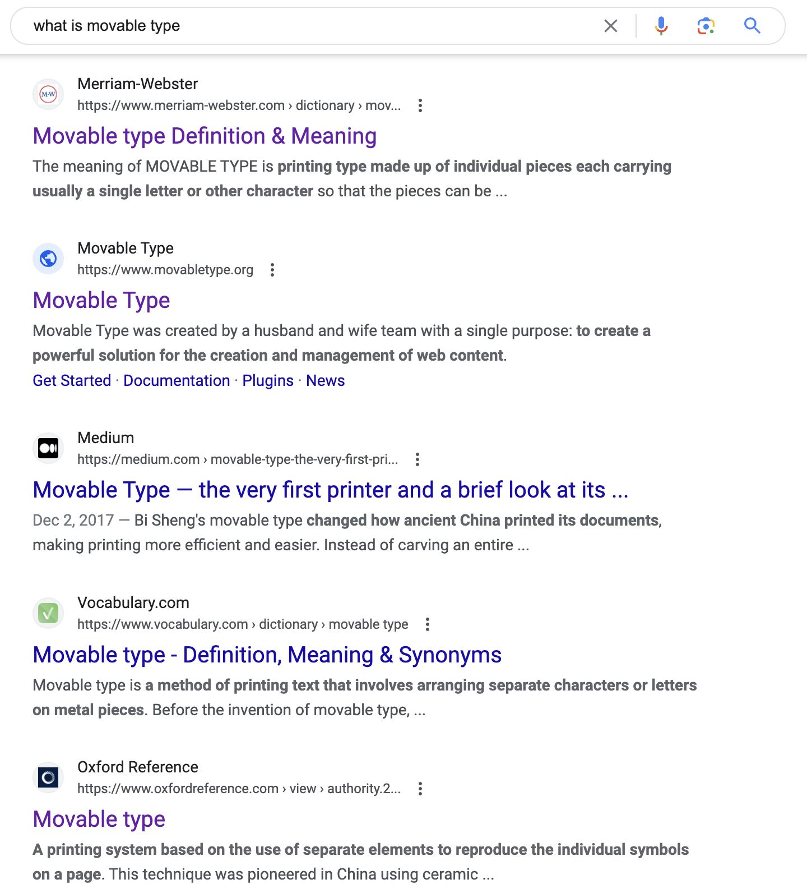
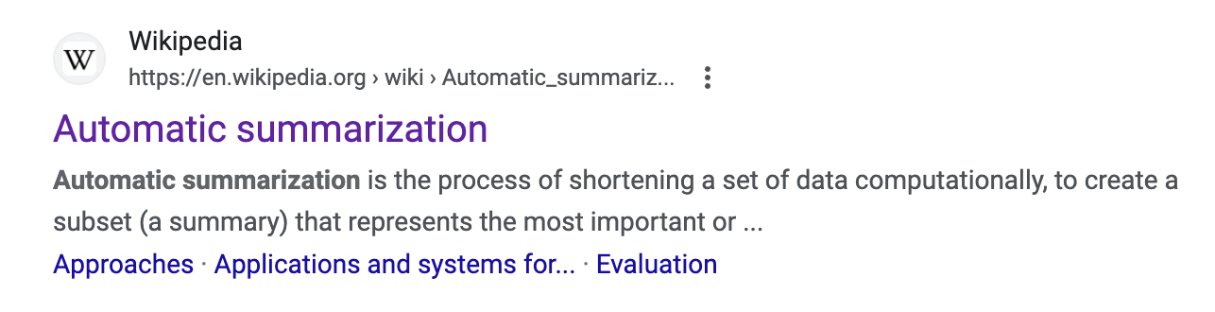
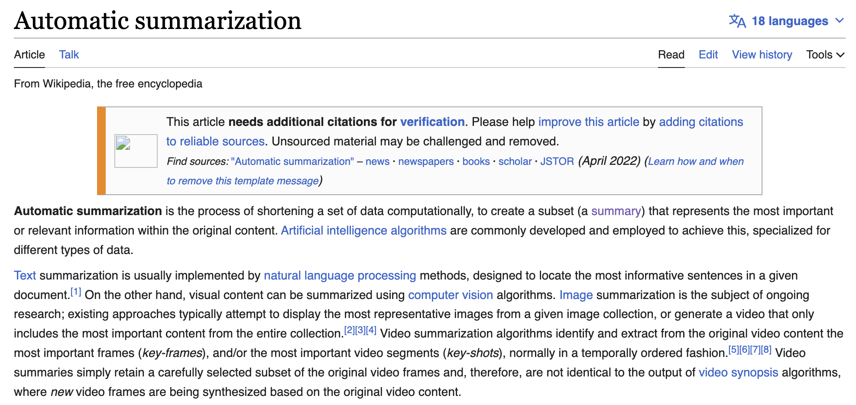
Simple baseline: take the first sentence
Notes:
Snippets: query-focused summaries

Slide 34
Summarization: Three Stages
Summarization: Three Stages
content selection: choose sentences to extract from the document
information ordering: choose an order to place them in the summary
sentence realization: clean up the sentences
Content Selection
All sentences from documents
Extracted sentences
Sentence Realization (Sentence Simplification)
Document
Summary
Information Ordering
Sentence Extraction
Sentence Segmentation

Slide 35
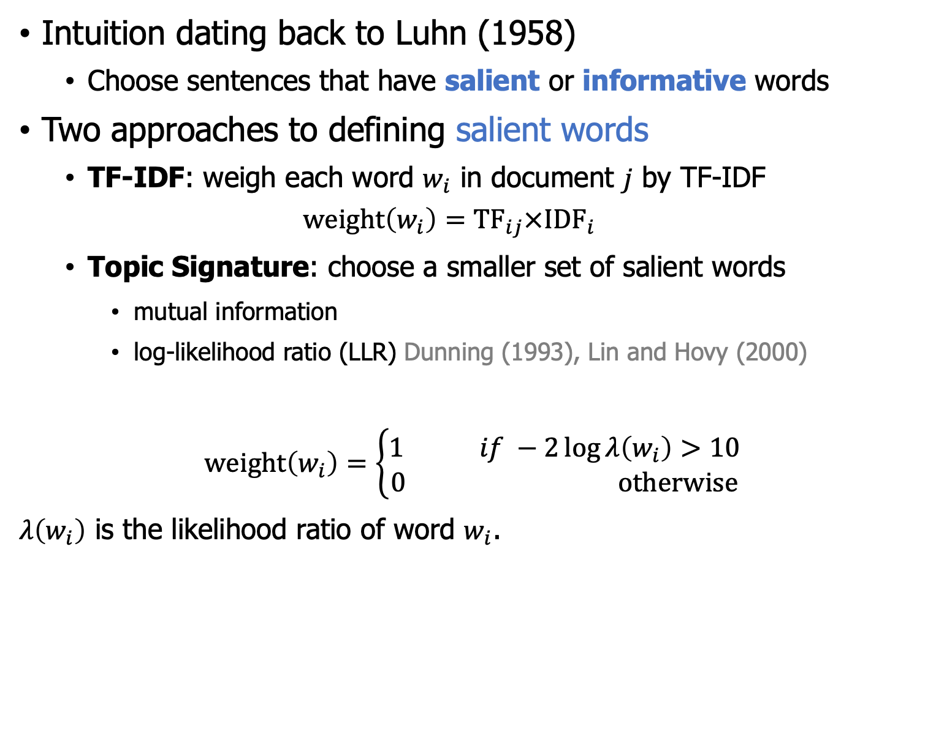
Unsupervised content selection
Intuition dating back to Luhn (1958)
Choose sentences that have salient or informative words
Two approaches to defining salient words
TF-IDF: weigh each word $w_{i}$ in document $j$ by TF-IDF
$$weight\left(w_{i}\right)=TF_{ij}×IDF_{i}$$
Topic Signature: choose a smaller set of salient words
mutual information
log-likelihood ratio (LLR) Dunning (1993), Lin and Hovy (2000)
$$weight\left(w_{i}\right)=\left\{\begin{aligned}1 if −2\log{λ\left(w_{i}\right)>10} \\ 0 otherwise\end{aligned}\right.$$
$λ\left(w_{i}\right)$ is the likelihood ratio of word $w_{i}$.
the assumption that semantically related terms tend to co-occur

Slide 36
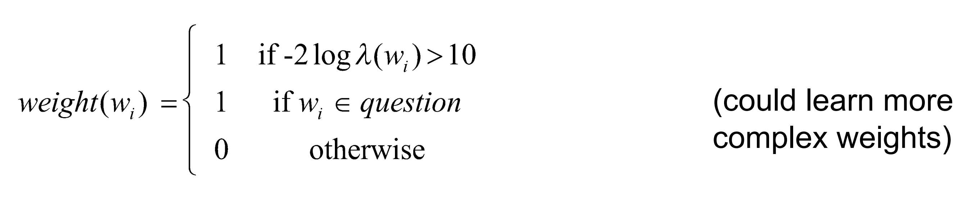
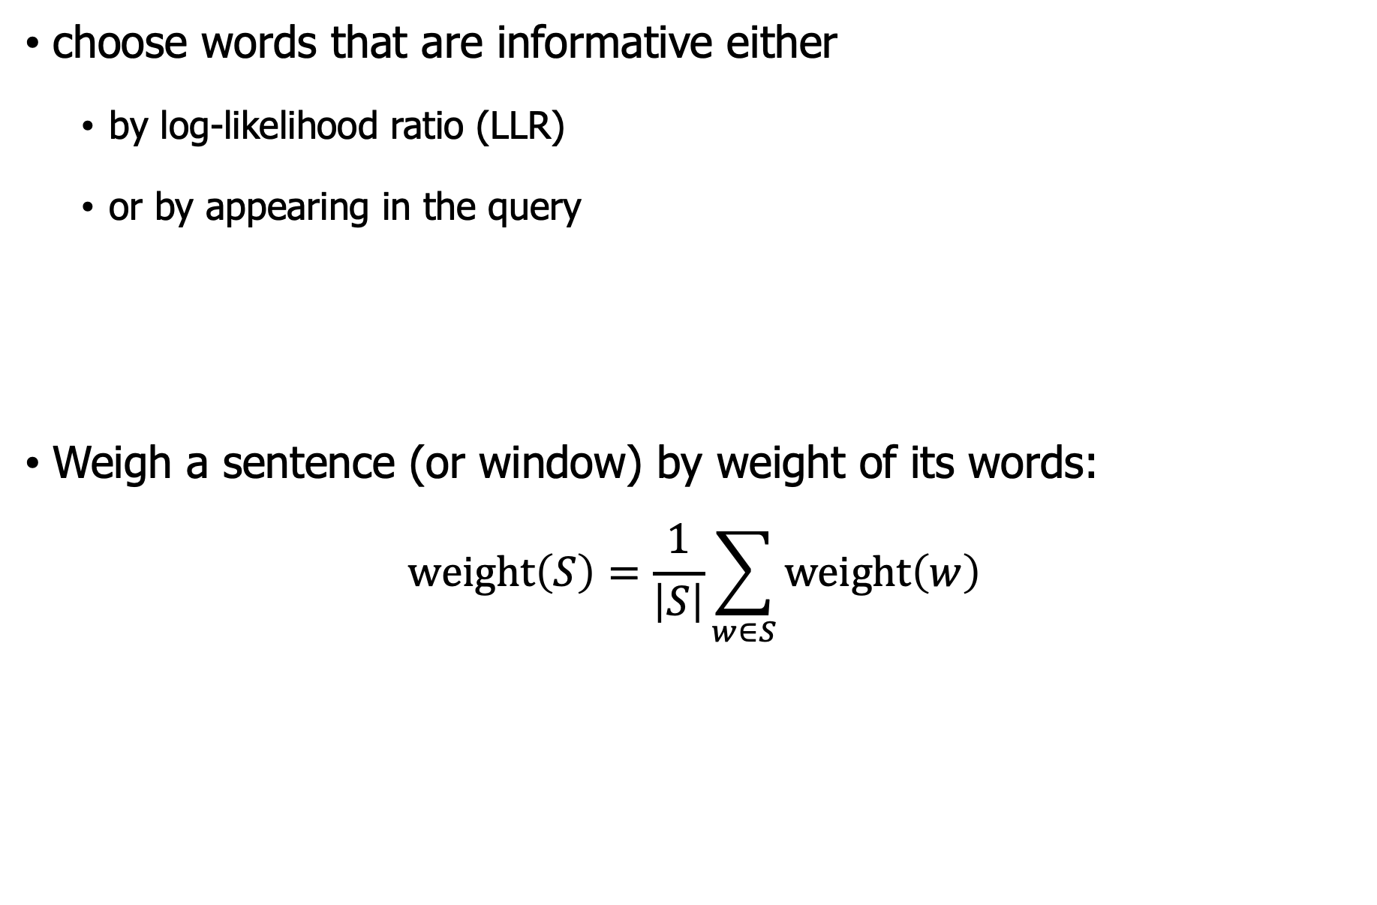
Unsupervised content selection (queries)
choose words that are informative either
by log-likelihood ratio (LLR)
or by appearing in the query
Weigh a sentence (or window) by weight of its words:
$$weight\left(S\right)=\frac{1}{\left|S\right|}\sum_{w∈S}{weight\left(w\right)}$$

Slide 37
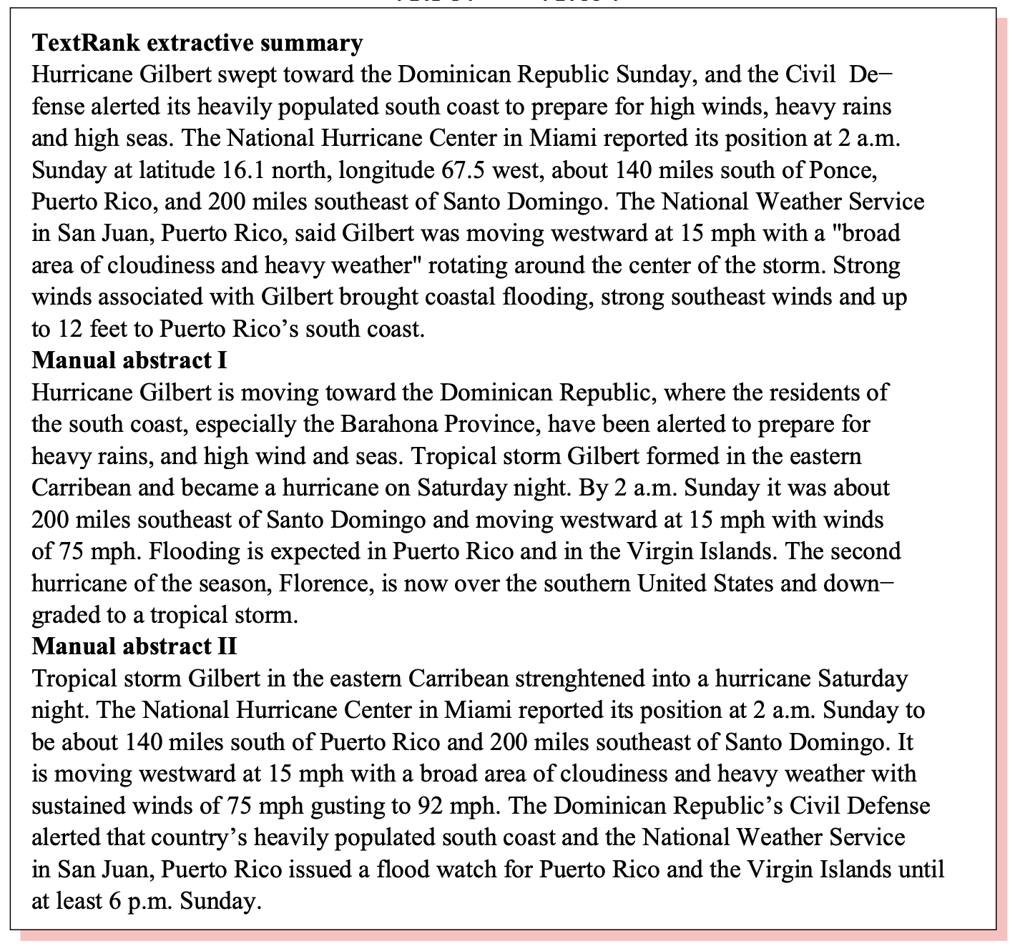
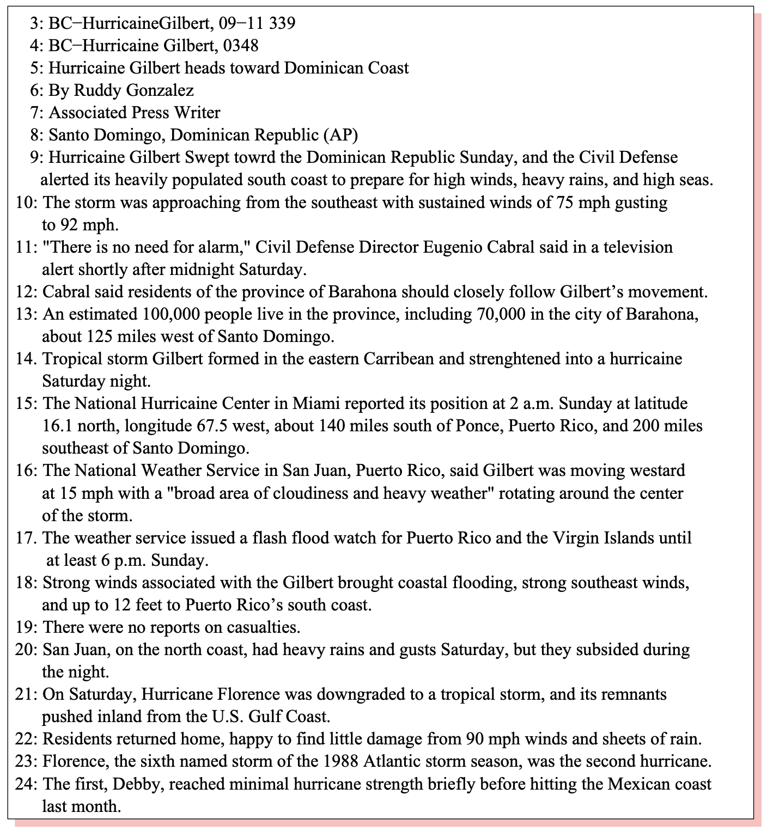
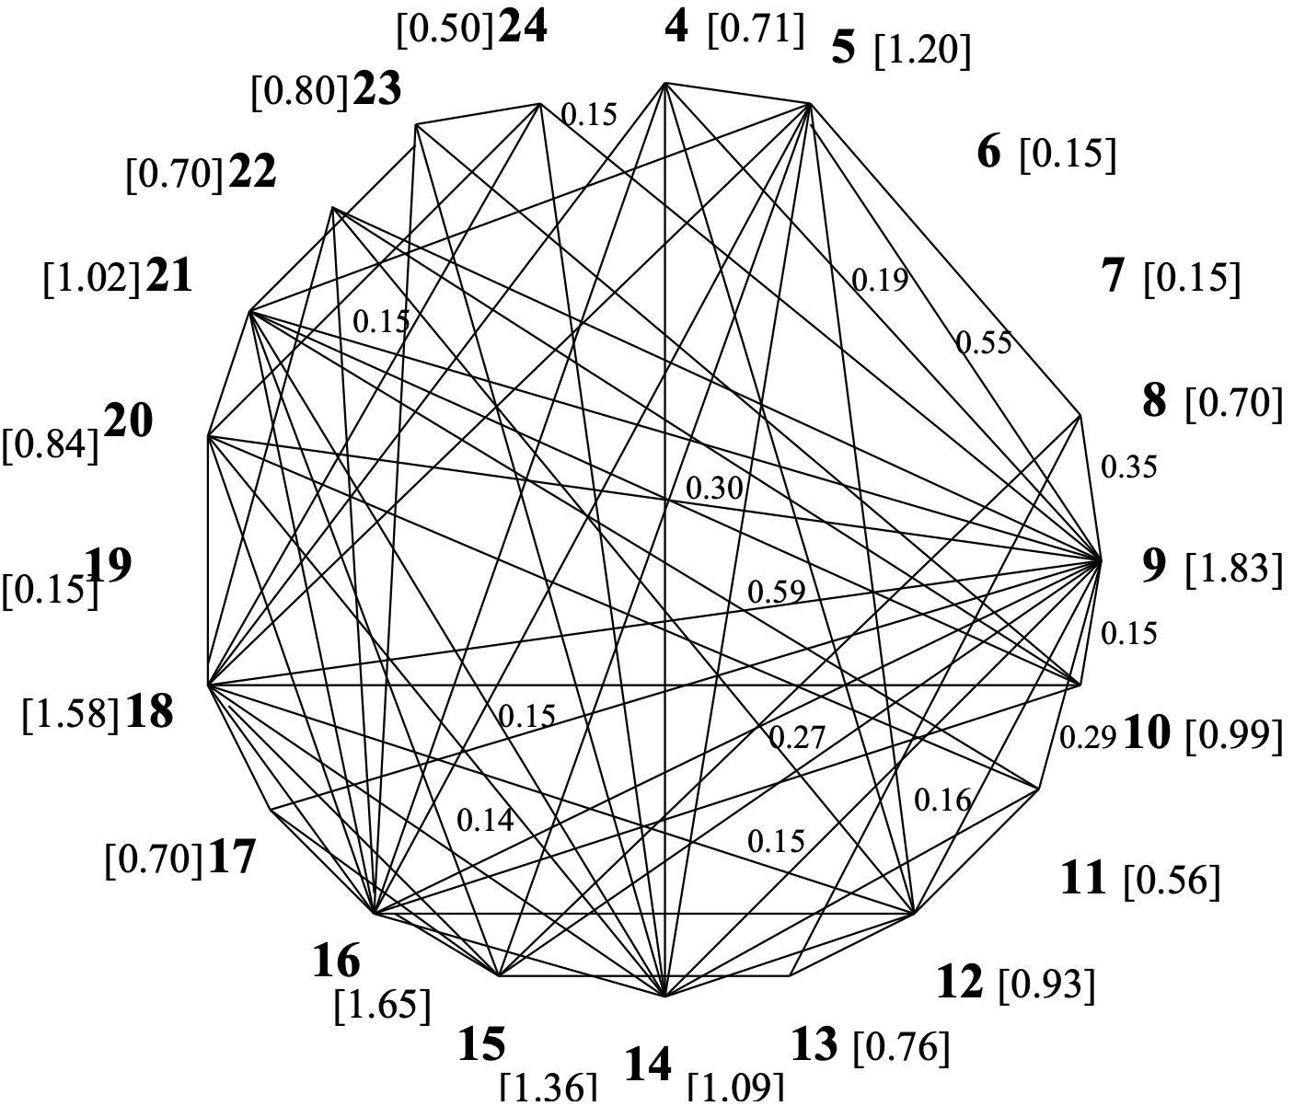
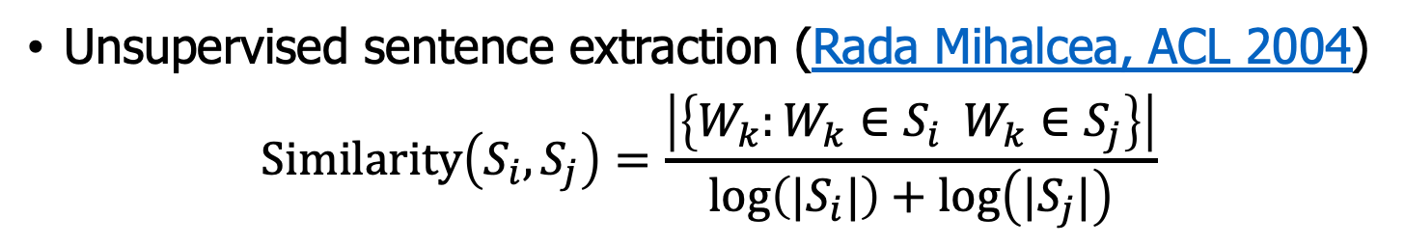
Graph-based Ranking Algorithms
Unsupervised sentence extraction (Rada Mihalcea, ACL 2004)
$$Similarity\left(S_{i},S_{j}\right)=\frac{\left|\left\{W_{k}:W_{k}∈S_{i} W_{k}∈S_{j}\right\}\right|}{\log\left(|S_{i}|\right)+\log\left(|S_{j}|\right)}$$

Slide 38
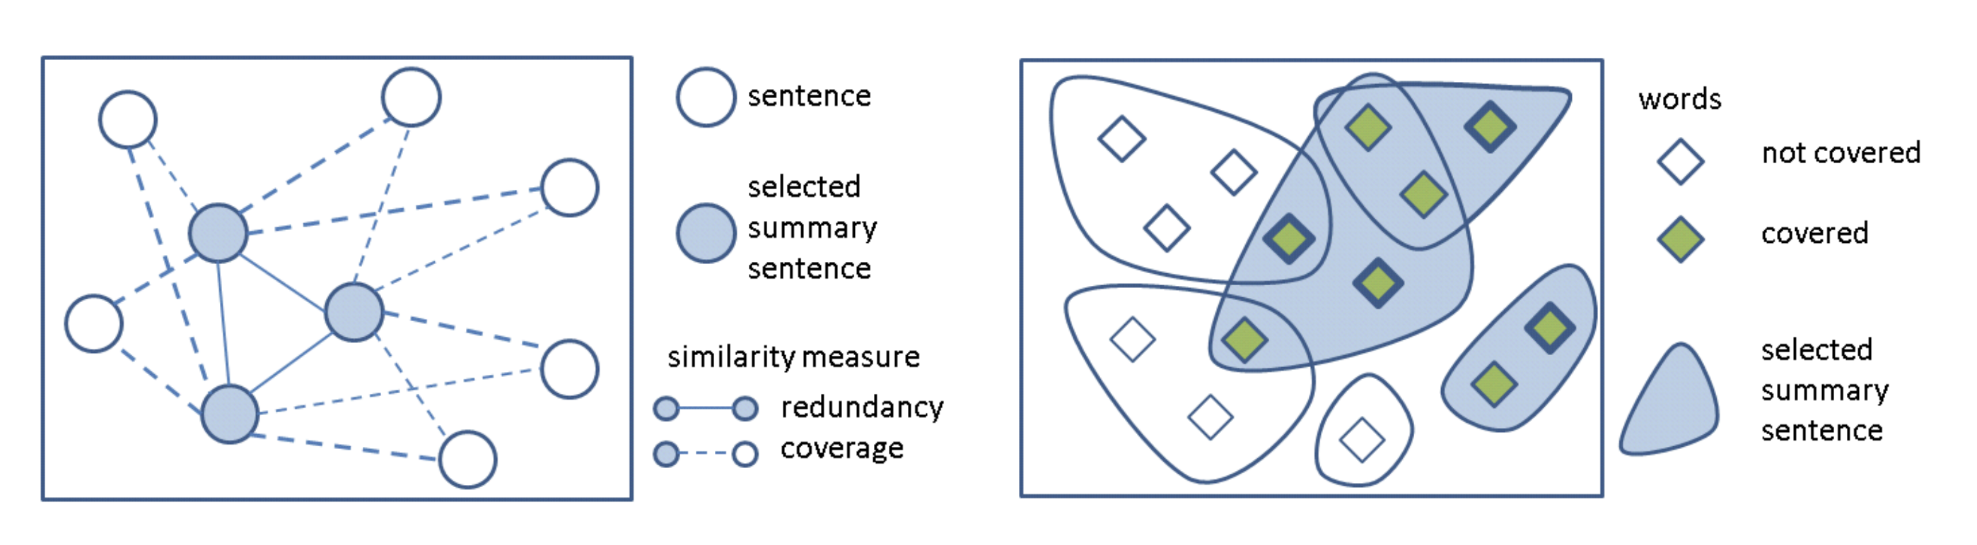

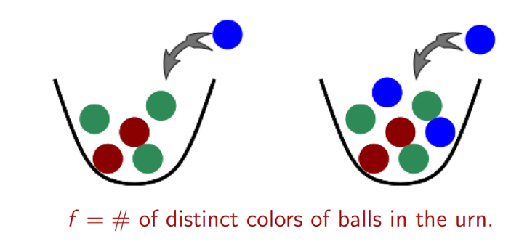
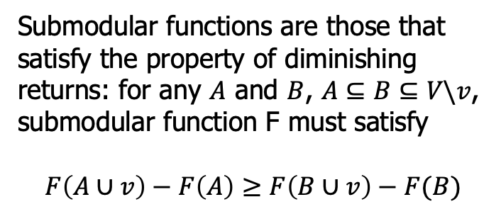
Submodular functions for summarization
Functions can be designed as monotone nondecreasing and submodular, which means that an efficient scalable greedy optimization scheme has a constant factor guarantee of optimality.
Submodular functions are those that satisfy the property of diminishing returns: for any $A$ and $B$, $A⊆B⊆V\backslash v$, submodular function F must satisfy
$$F\left(A∪v\right)−F\left(A\right)≥F\left(B∪v\right)−F(B)$$
https://aclanthology.org/P11-1052.pdf

Slide 39
Supervised content selection
Given
a labeled training set of good summaries for each document
Align
the sentences in the document with sentences in the summary
Extract features
position (first sentence?)
length of sentence
word informativeness, cue phrases
cohesion
Train
a binary classifier (put sentence in summary? yes or no)
Problems
hard to get labeled training
alignment difficult
performance not better than unsupervised algorithms
In practice
Unsupervised content selection is more common

Slide 40
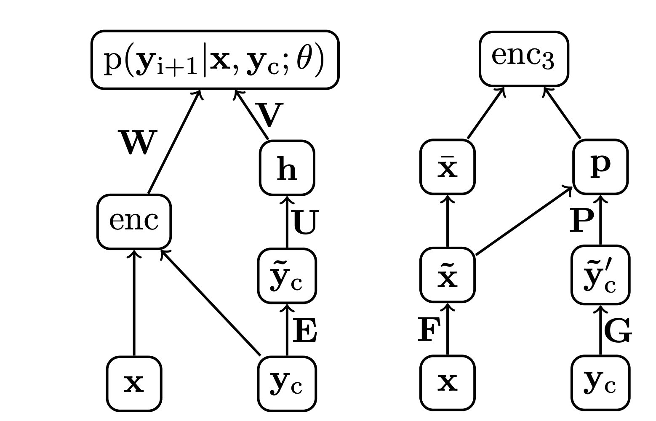
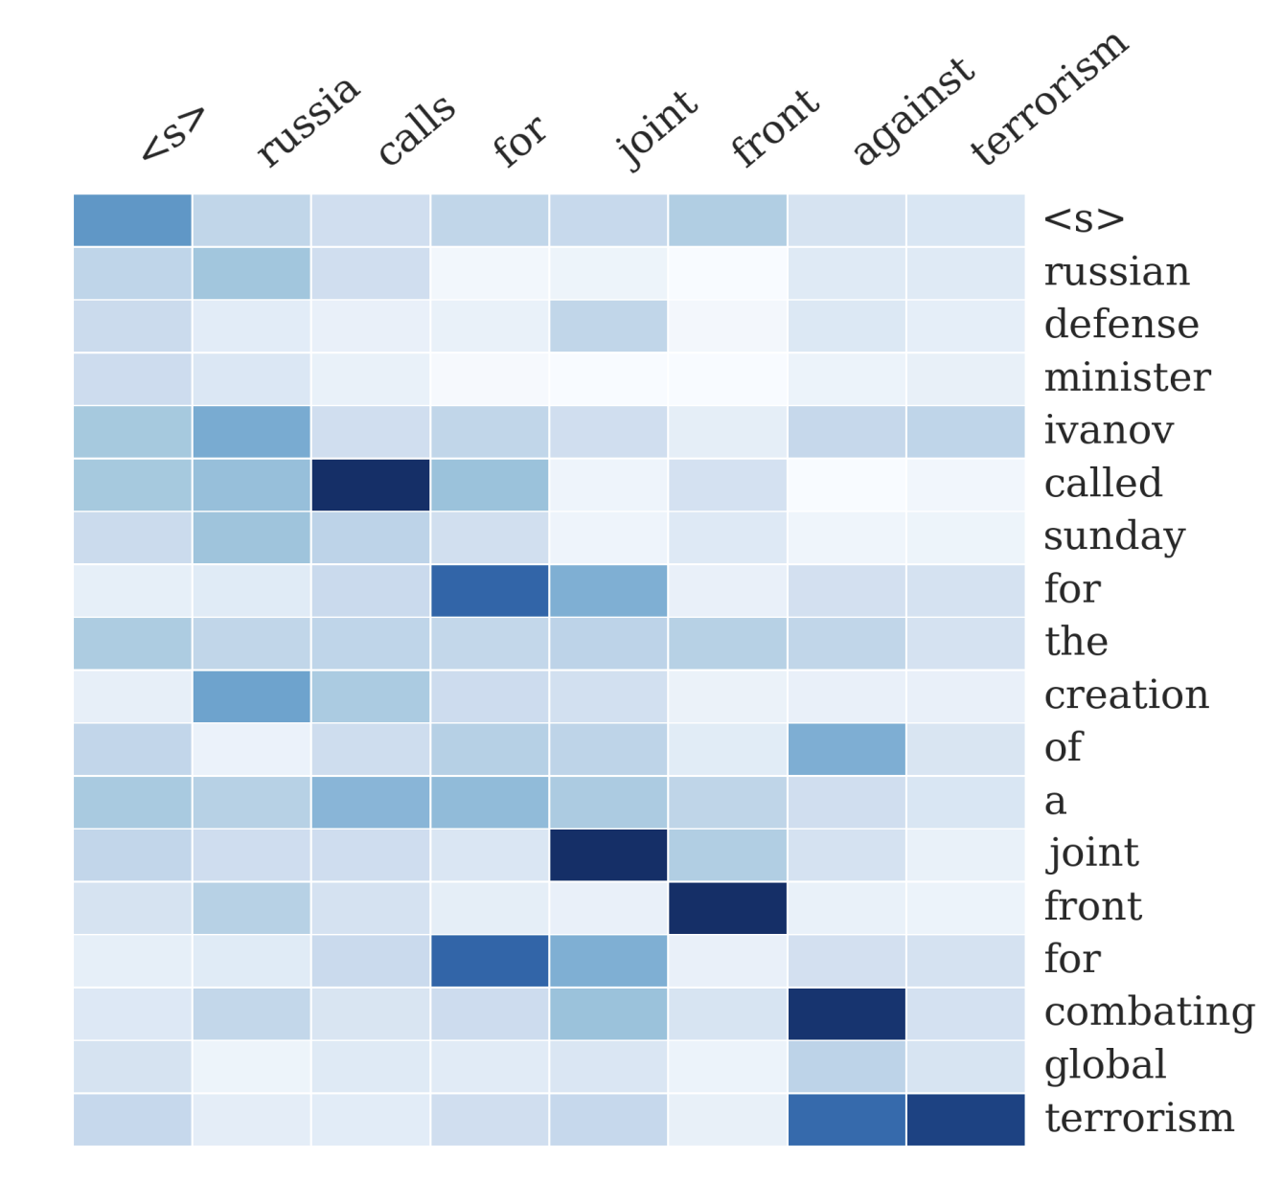
A neural attention model for abstractive sentence summarization
Inspired by attention-based seq2seq models (Bahdanau, 2014), Rush et al., EMNLP 2015
A network diagram for the NNLM decoder with additional encoder element
A network diagram for the attention-based encoder enc3.

Slide 41
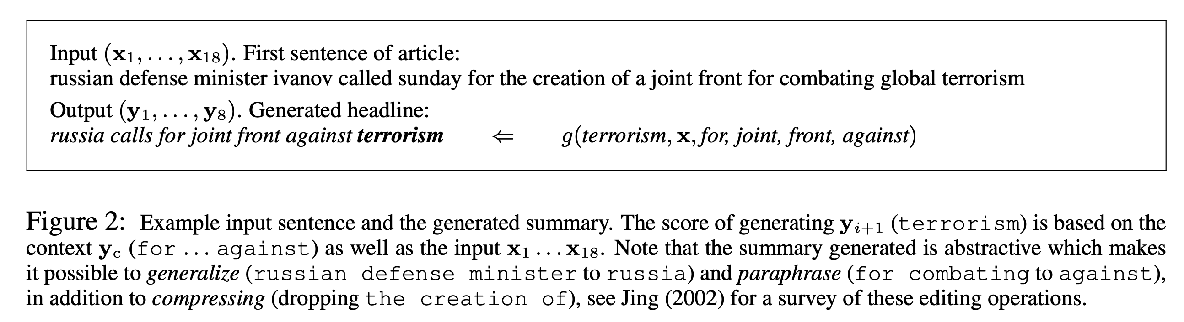
A neural attention model for abstractive sentence summarization
Inspired by attention-based seq2seq models (Bahdanau, 2014), Rush et al., EMNLP 2015

Slide 42
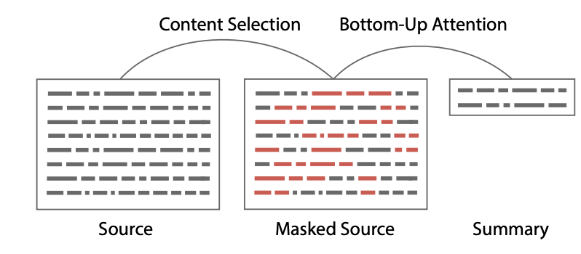
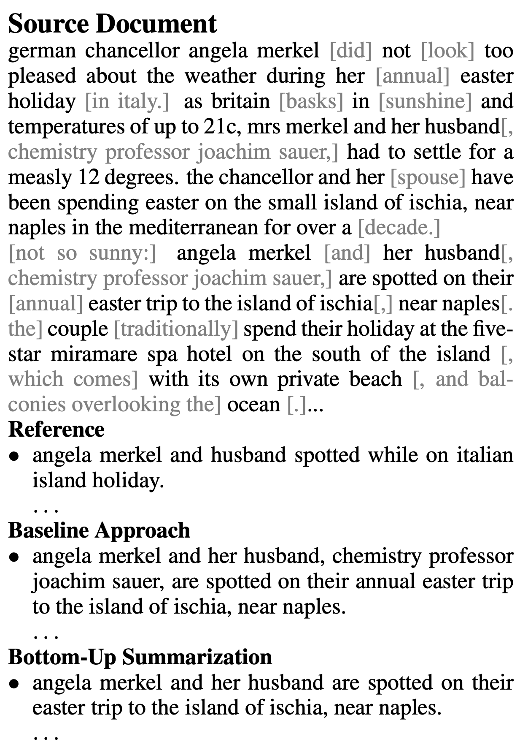
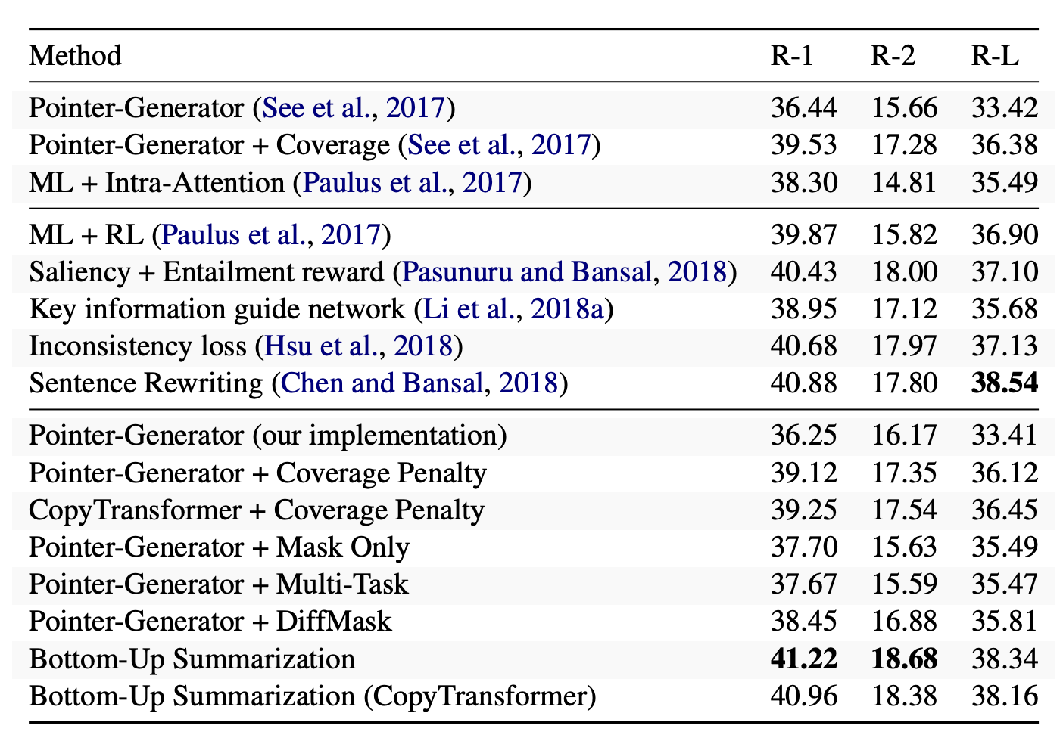
Hybrid approach (Bottom-Up)
“Bottom-Up Abstractive Summarization” (Gehrmann et al., AAAI 2017)

Slide 43
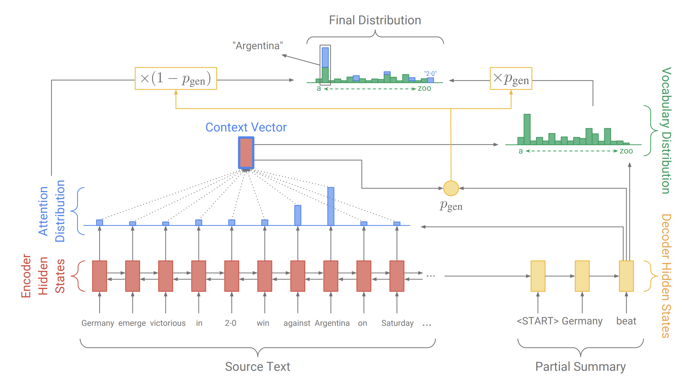
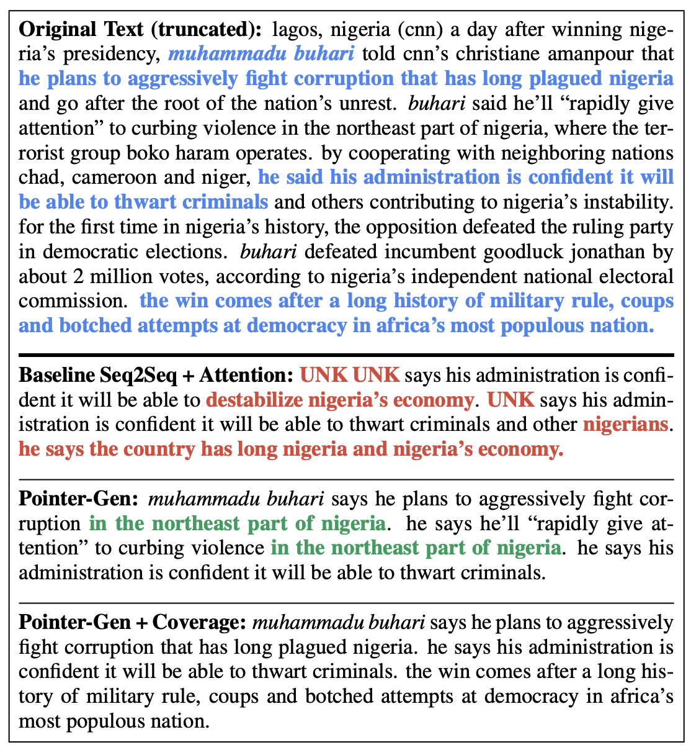
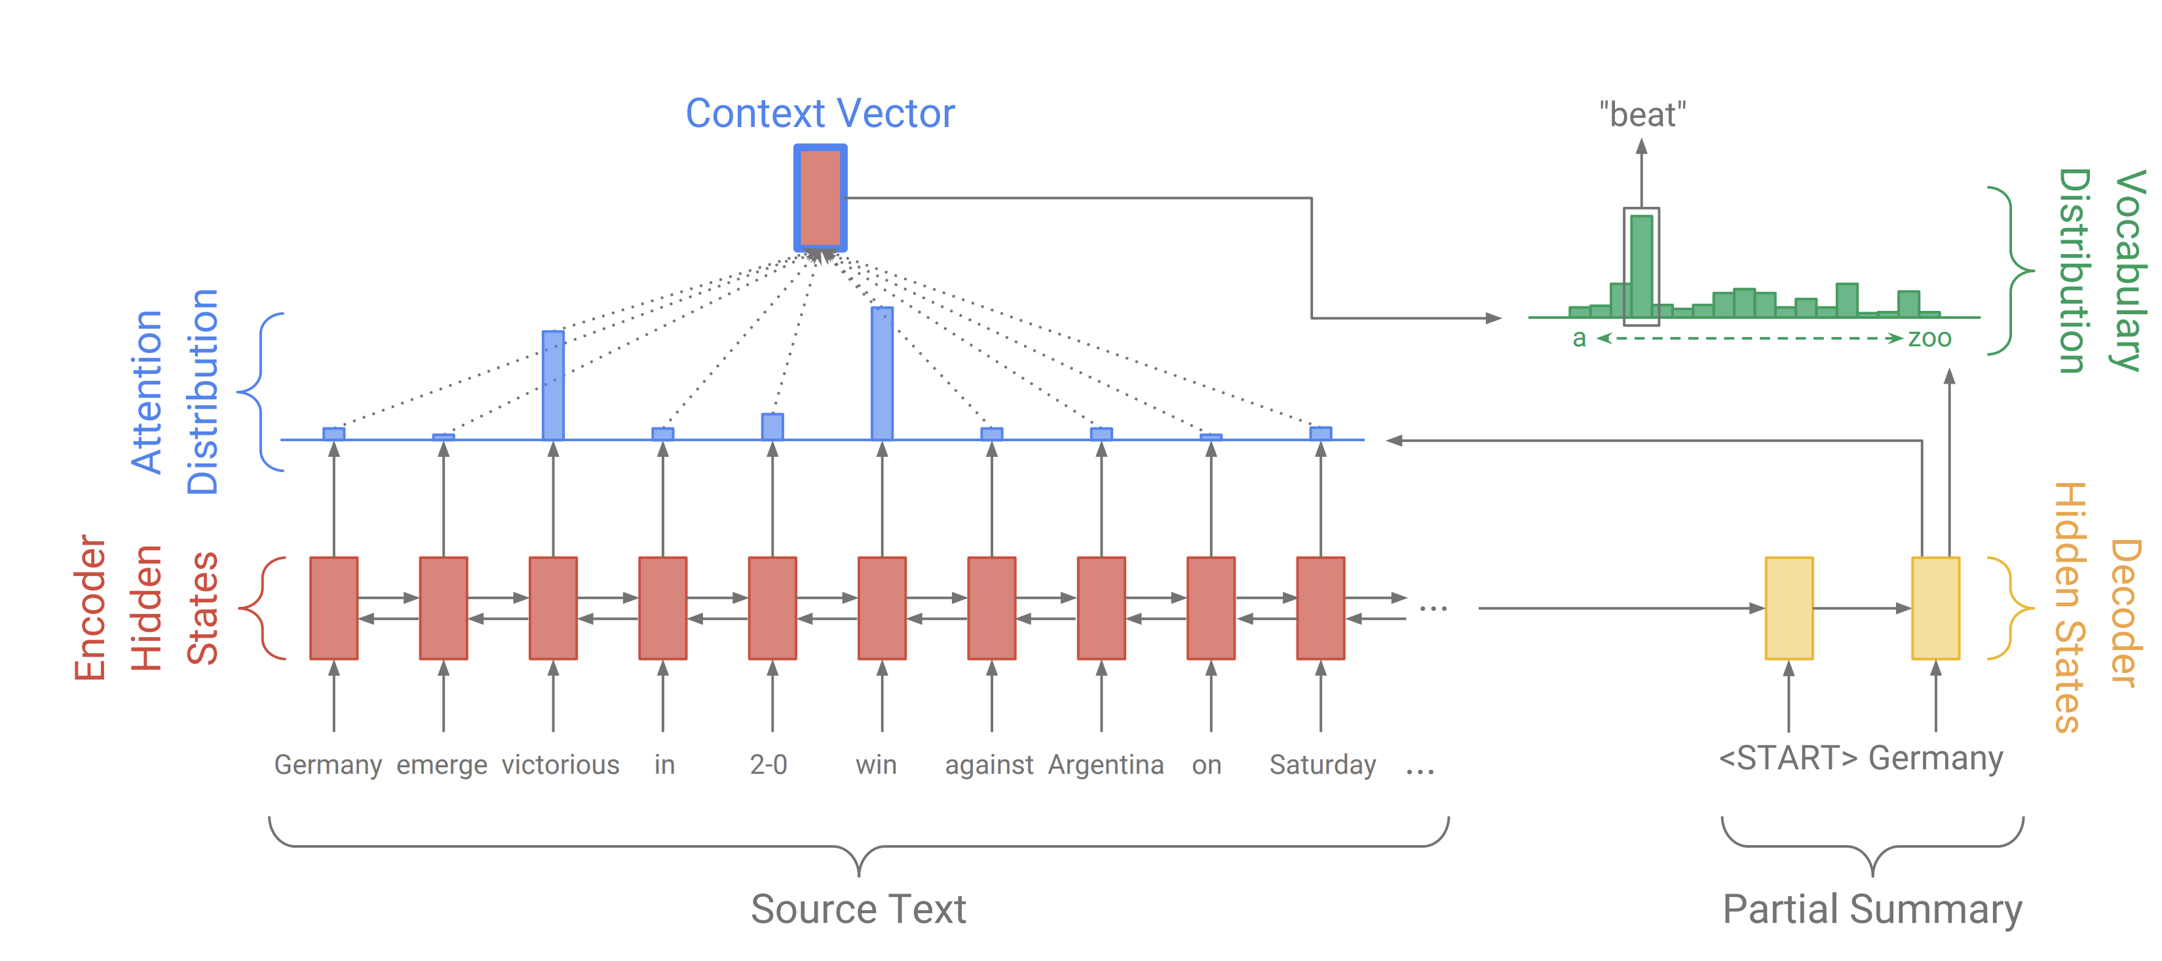
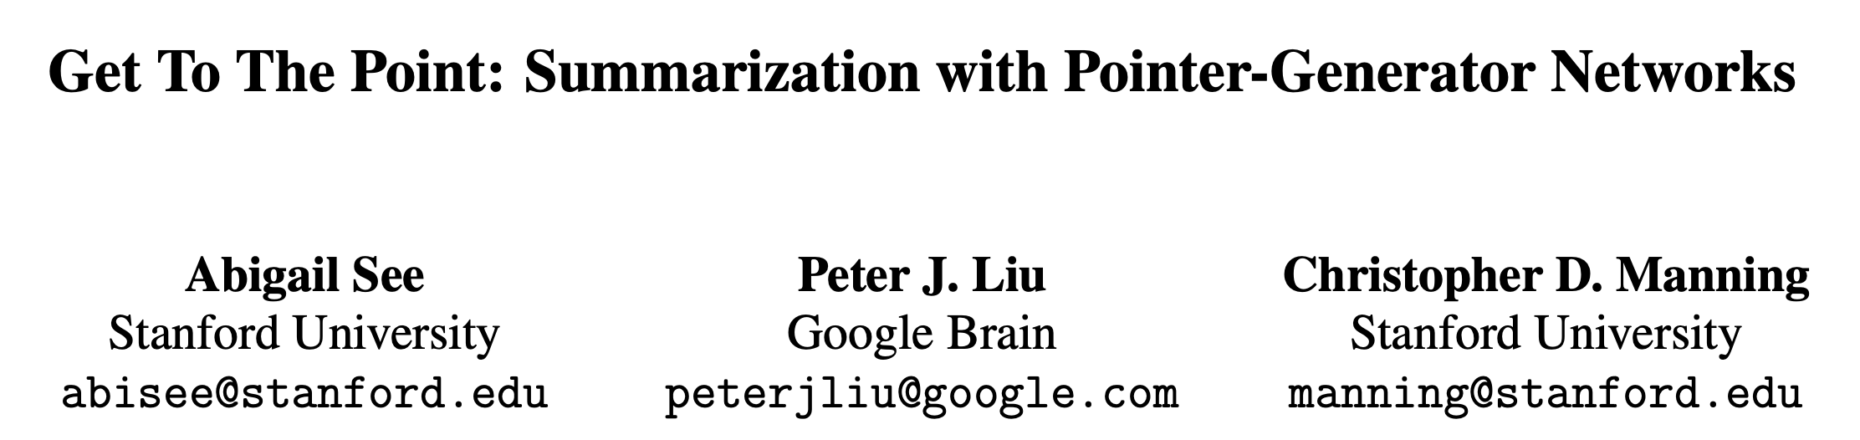
Pointer Generator Networks
Copy words from the source text
https://arxiv.org/pdf/1704.04368.pdf

Slide 44
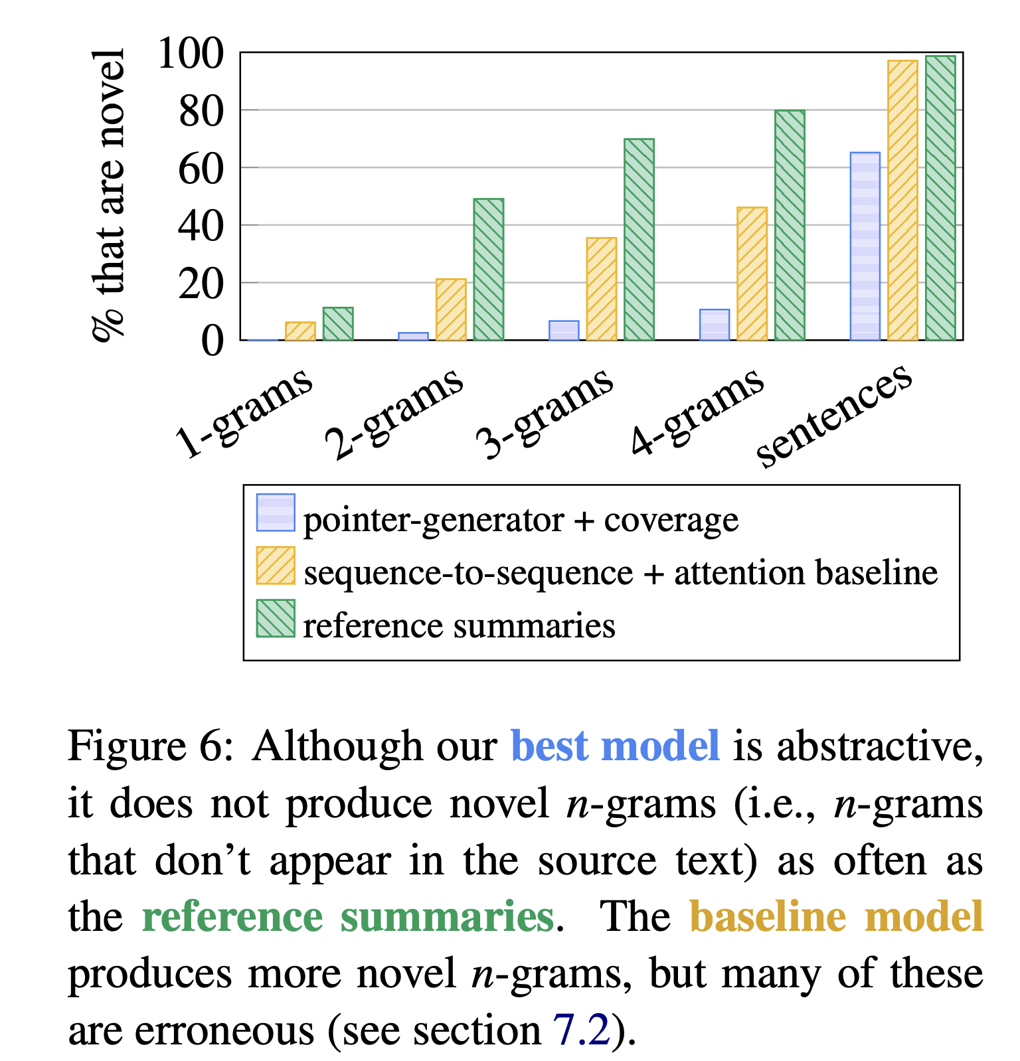
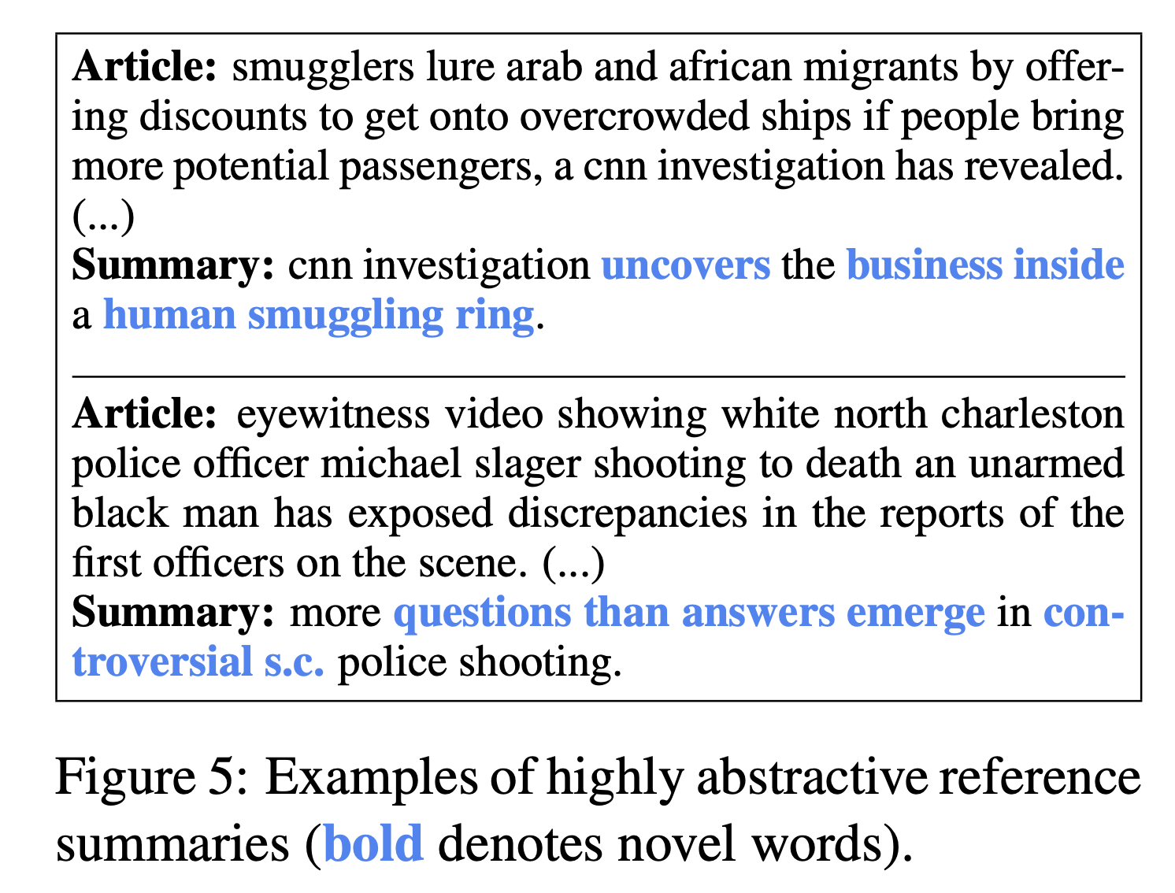
Pointer Generator Networks

Slide 45
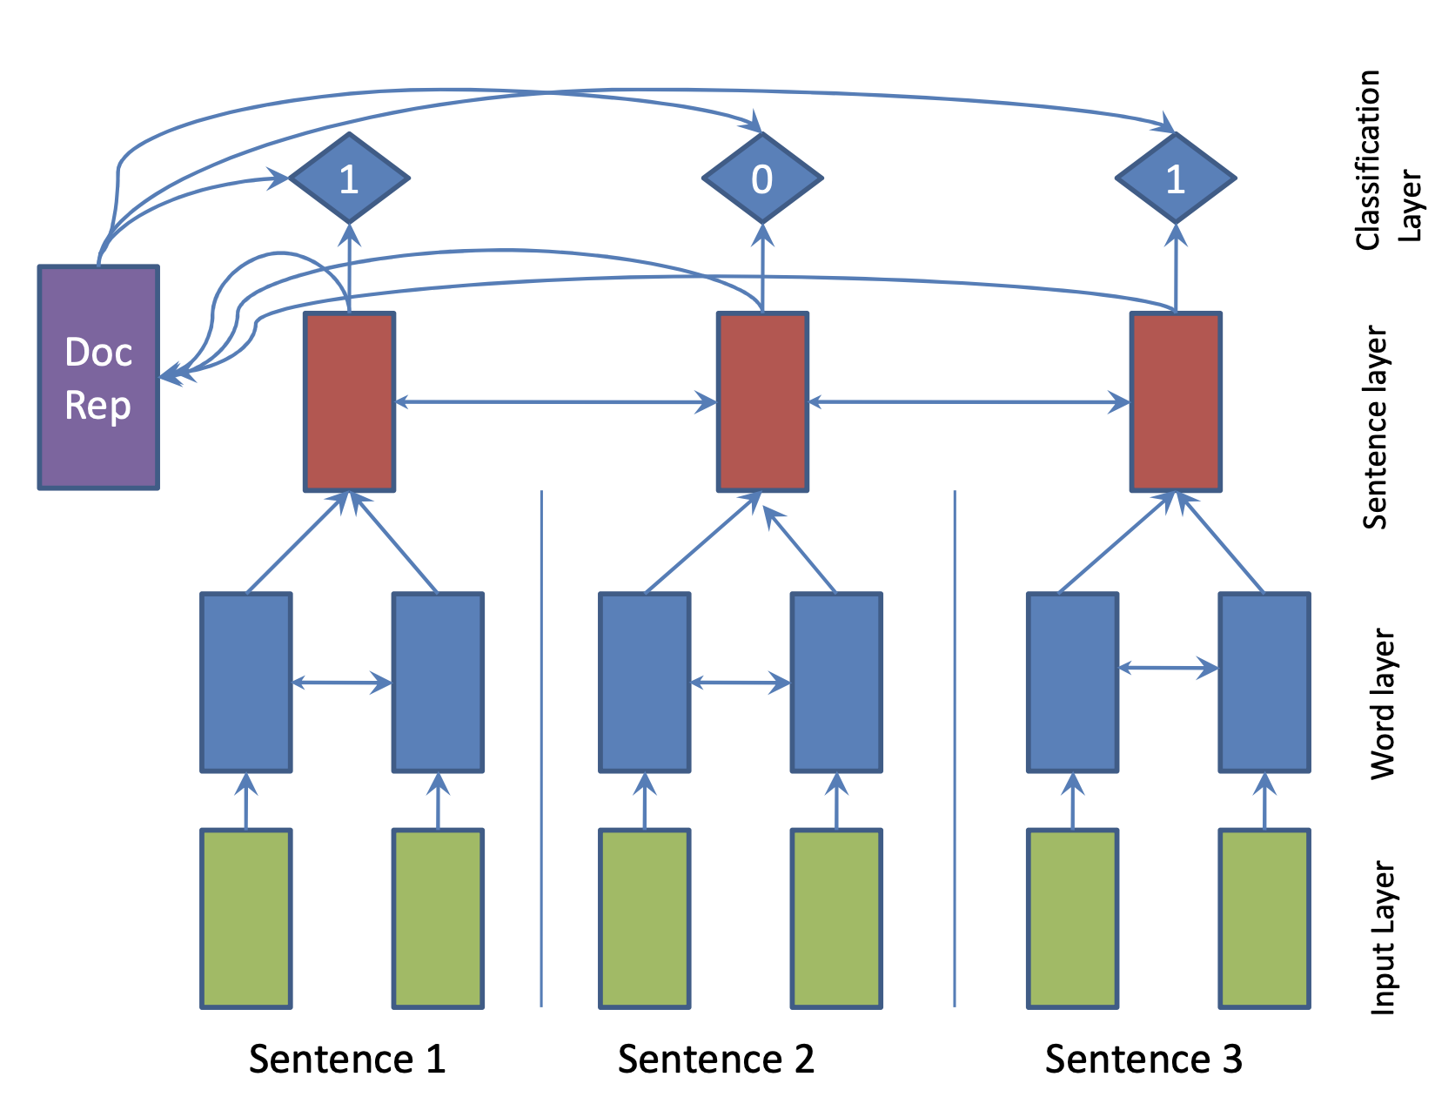

Neural Extractive Models
SummaRuNNer: A Recurrent Neural Network Based Sequence Model for Extractive Summarization of Documents.
The bottom layer
operates at word level within each sentence, while the top layer runs over sentences. Double-pointed arrows indicate a bi-directional RNN.
The top layer
with 1’s and 0’s is the sigmoid activation based classification layer that decides whether or not each sentence belongs to the summary.
The decision at each sentence depends on the content richness of the sentence, its salience with respect to the document, its novelty with respect to the accumulated summary representation and other positional features.
https://arxiv.org/pdf/1611.04230.pdf

Slide 46
Other lines
Coverage Mechanism
“Modeling Coverage for Neural Machine Translation” (Tu et al., 2016 ACL)
Graph-based attentional neural model
“Abstractive document summarization with a graph-based attentional neural model” (Tan et al., ACL 2017)
Reinforcement Learning
“A deep reinforced model for abstractive summarization.” (Paulus et al., ICLR 2018)

Slide 47
Summarization using Pretrained LMs
Pretrained LMs
BART/BERT
T5
ChatGPT, GPT-2, GPT-3, GPT-4
Fine-tuning: A pre-trained model is fine-tuned on a summarization task dataset. Such a dataset consists of pairs of input documents and their manually created summaries, often by subject matter experts that have a great idea of the perfect “goal state” summary for the use case.

Slide 48



Example: Summarization in Education
Sample essay (Kaggle's automated essay scoring dataset)
GPT-3 series
The essay has some spelling mistakes, grammar errors, and structural weaknesses. We can consider it a rather noisy input, the kind that's quite common in the real world. The student has used the first-person point of view.

Slide 49

Example: Summarization in Education
Sample essay (Kaggle's automated essay scoring dataset)
The essay has some spelling mistakes, grammar errors, and structural weaknesses. We can consider it a rather noisy input, the kind that's quite common in the real world. The student has used the first-person point of view.
The four extractive models, though SOTA, retain too many errors and spurious text to be useful in practice. Use them only if your documents are of good quality.

Slide 50



Example: Summarization of Medical Reports
medical report from the Kaggle medical transcriptions dataset
The first three GPT-3 models — Davinci, Curie, and Babbage — retain and summarize much of the relevant details (along with some irrelevant ones) though they discard the sections. Considering the size difference between these models it’s interesting to review the similarity of the outputs.

Slide 51

Example: Summarization of Medical Reports
medical report from the Kaggle medical transcriptions dataset
The four extractive models discard too many details. But this is not inherent and can be overcome by increasing parameters like the number of sentences to retain.

Slide 52


Example: Legal Documents Summarization
contract understanding Atticus dataset
All four extractive models do well to tell us the signing parties, but the usefulness of the other details is relative as most summarization tasks of information dense documents.

Slide 53


Summarization of Research Papers
https://huggingface.co/datasets/ccdv/arxiv-summarization
All four extractive models fare very poorly. It looks like they are tripping over some spurious text.

Slide 54
Recap
Salient Detection
How to detect important/relevant words or sentences?
Statistical Methods -> Neural Extractive Models -> LLM-based
Remaining Challenges
Long text abstractive summarization
Abstractive multi-document summarization

Slide 55
References
https://github.com/mathsyouth/awesome-text-summarization
https://www.width.ai/post/bart-text-summarization
Algorithms for NLP: http://demo.clab.cs.cmu.edu/algo4nlp19/
http://demo.clab.cs.cmu.edu/algo4nlp19/slides/summarization.pdf

